Slide 1
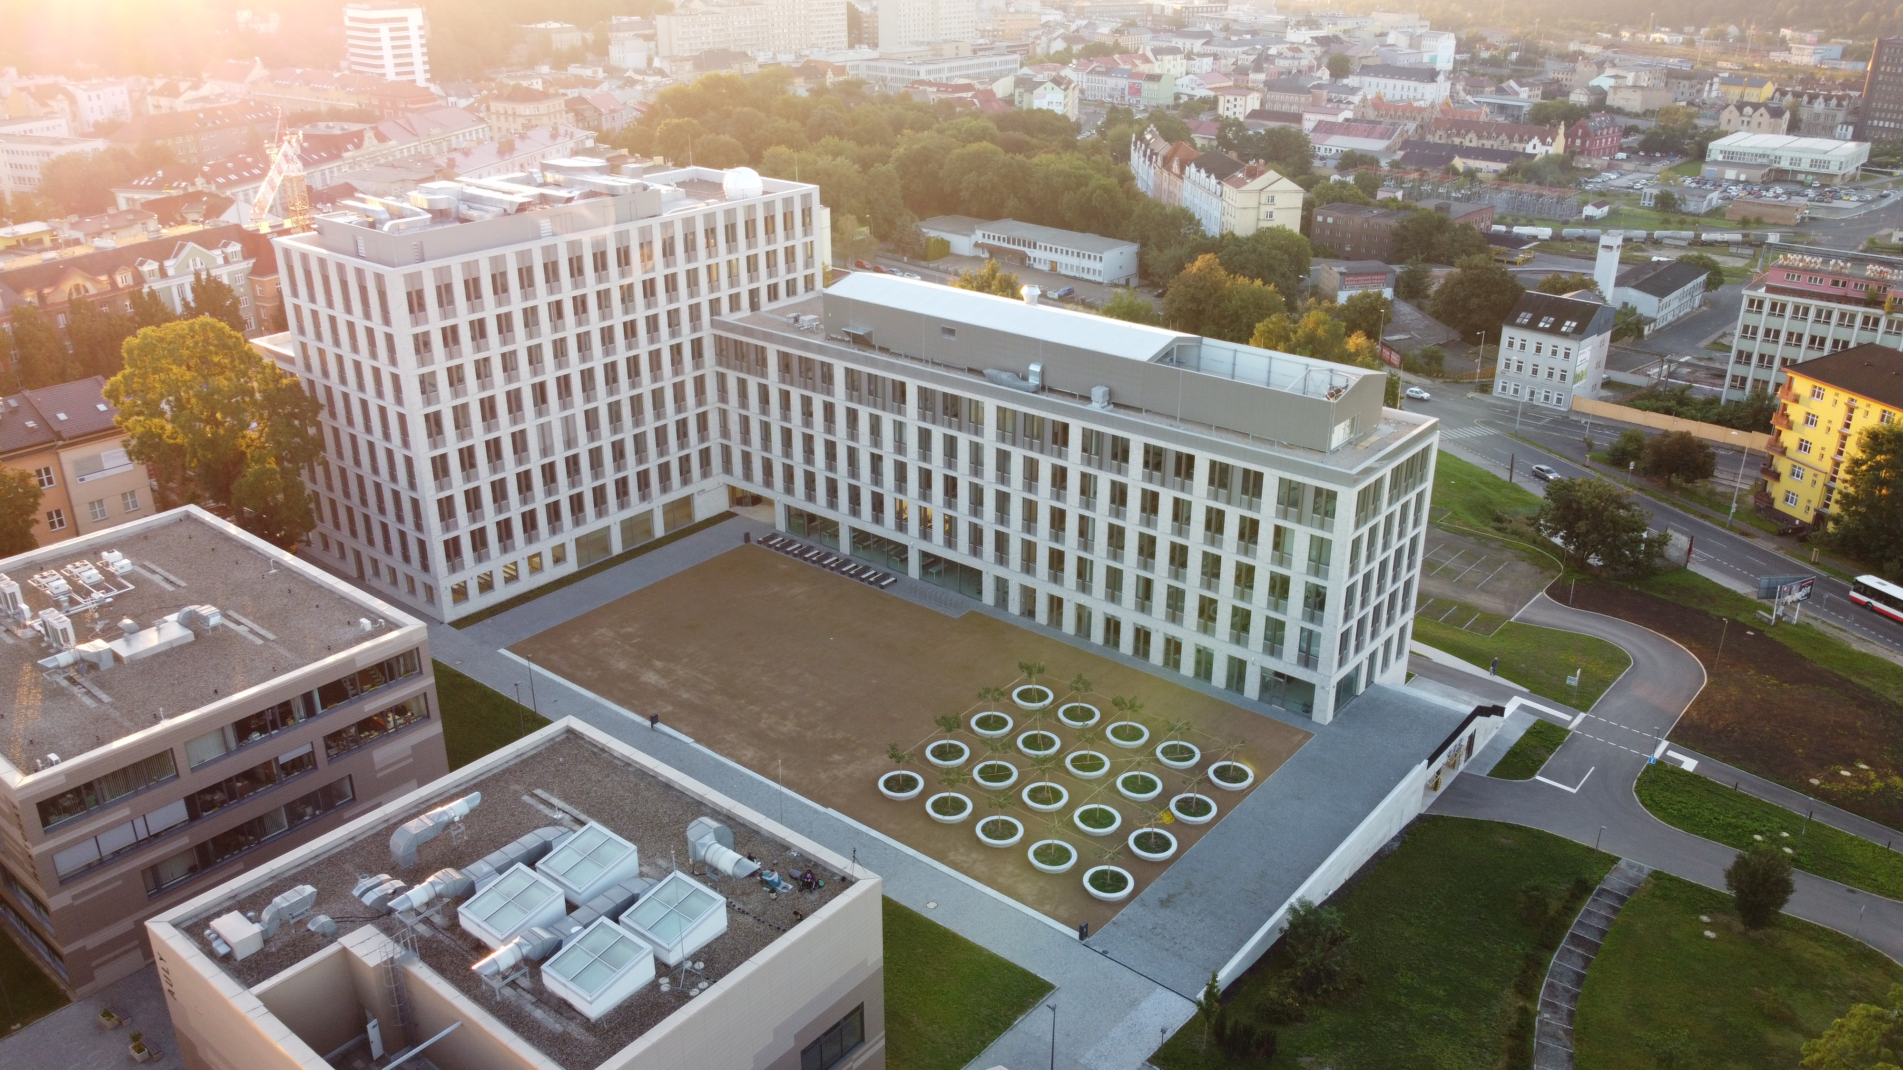

Jan Evangelista Purkyně University
in Ústí nad Labem
Czechia
Presenter:
Full name and titles
www.ujep.cz/en

Slide 2
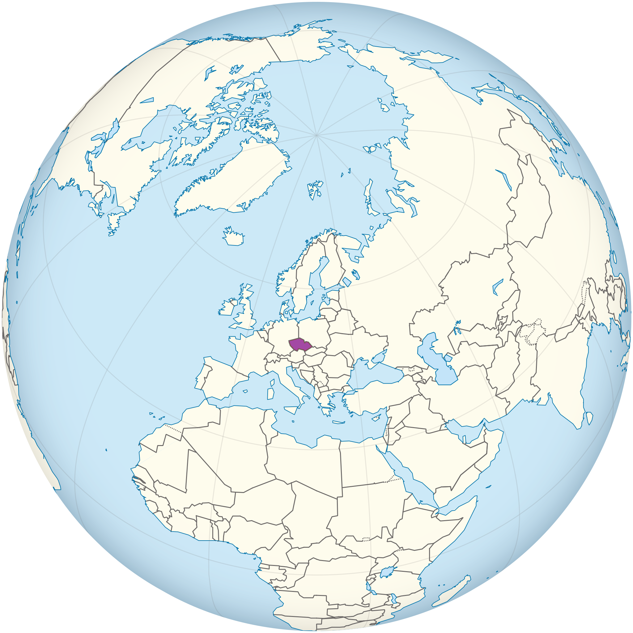

Czechia
Area: 78.871 km²
Population: 10.5 million
Capital: Prague
Official language: Czech
Government: Unitary parliamentary republic
Organizations: EU, NATO, UN, OECD
…
Historical moments:
  first mentions around 7–9th Centuries
  Czechoslovakia since 1918
  Czech republic since 1993

Slide 3


University‘s location
Dresden
Ústí nad Labem
Population: 93 thousands
Foundation: 13th Century
University students: ca 8.000
65 km
Ústí nad Labem
120 km
90 km
Karlovy Vary
Prague

Slide 4
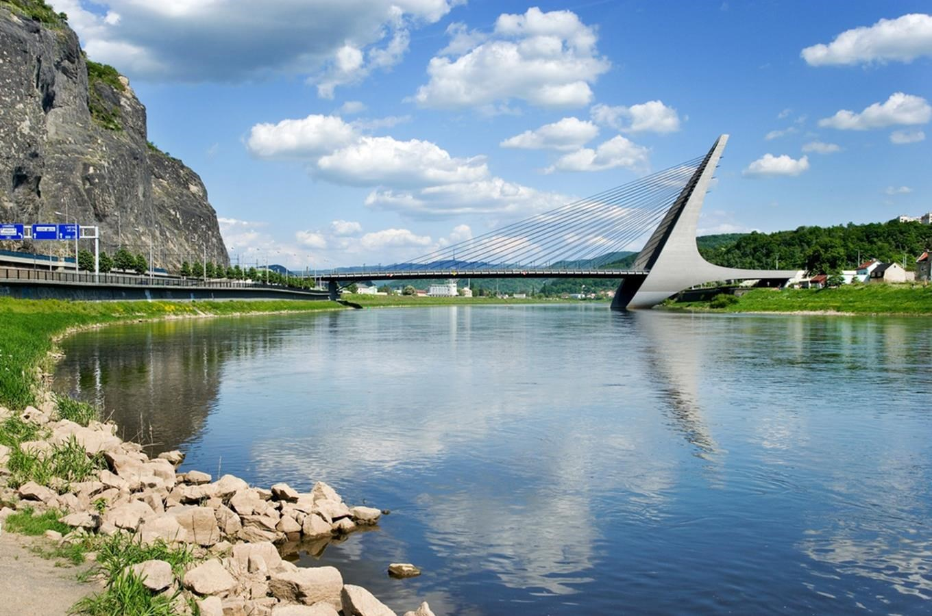
Ústí nad Labem
Administrative and cultural centre of our region.
Important junction connecting Prague with Germany.
Seat of the only university located in the region.
City with rough past developing every day.​
Surrounded by a stunning countryside​.

Slide 5
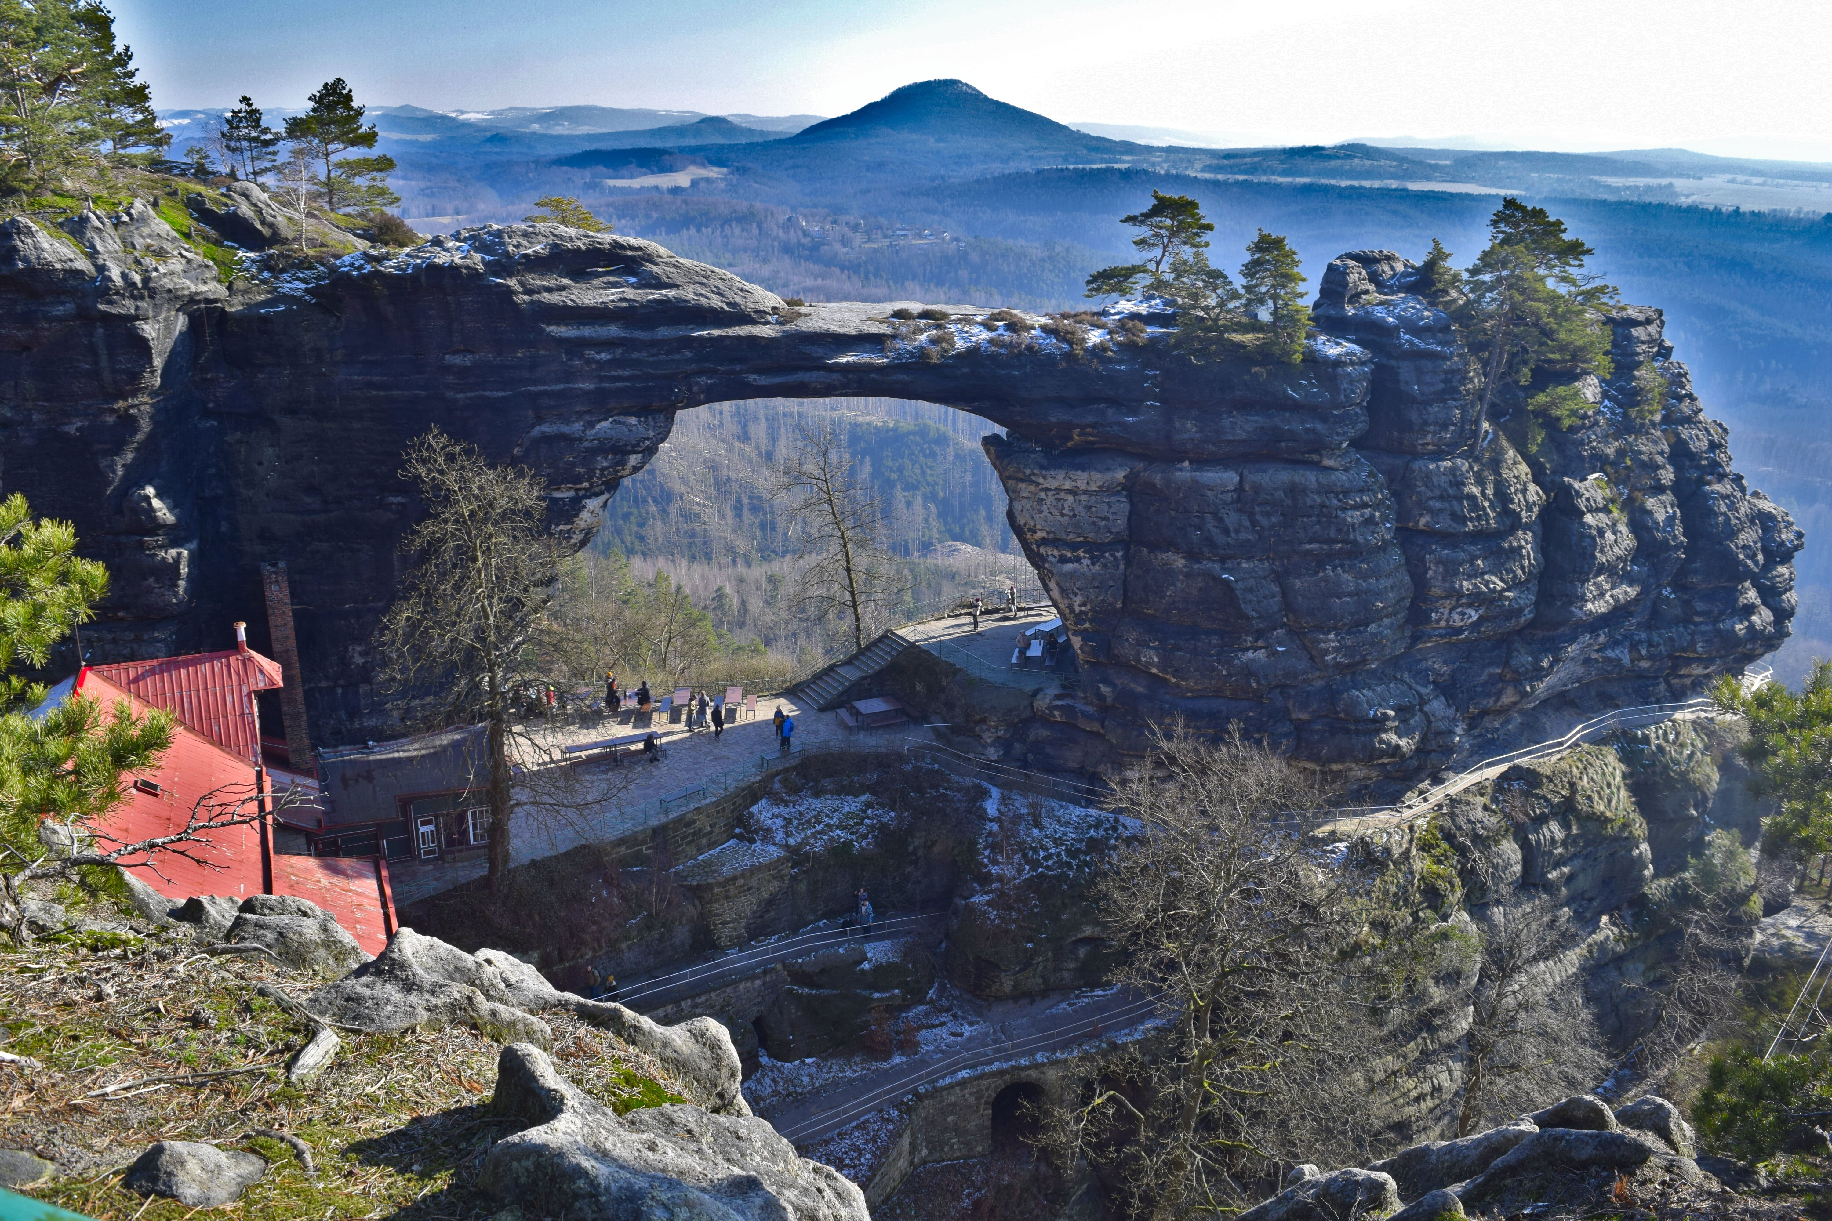
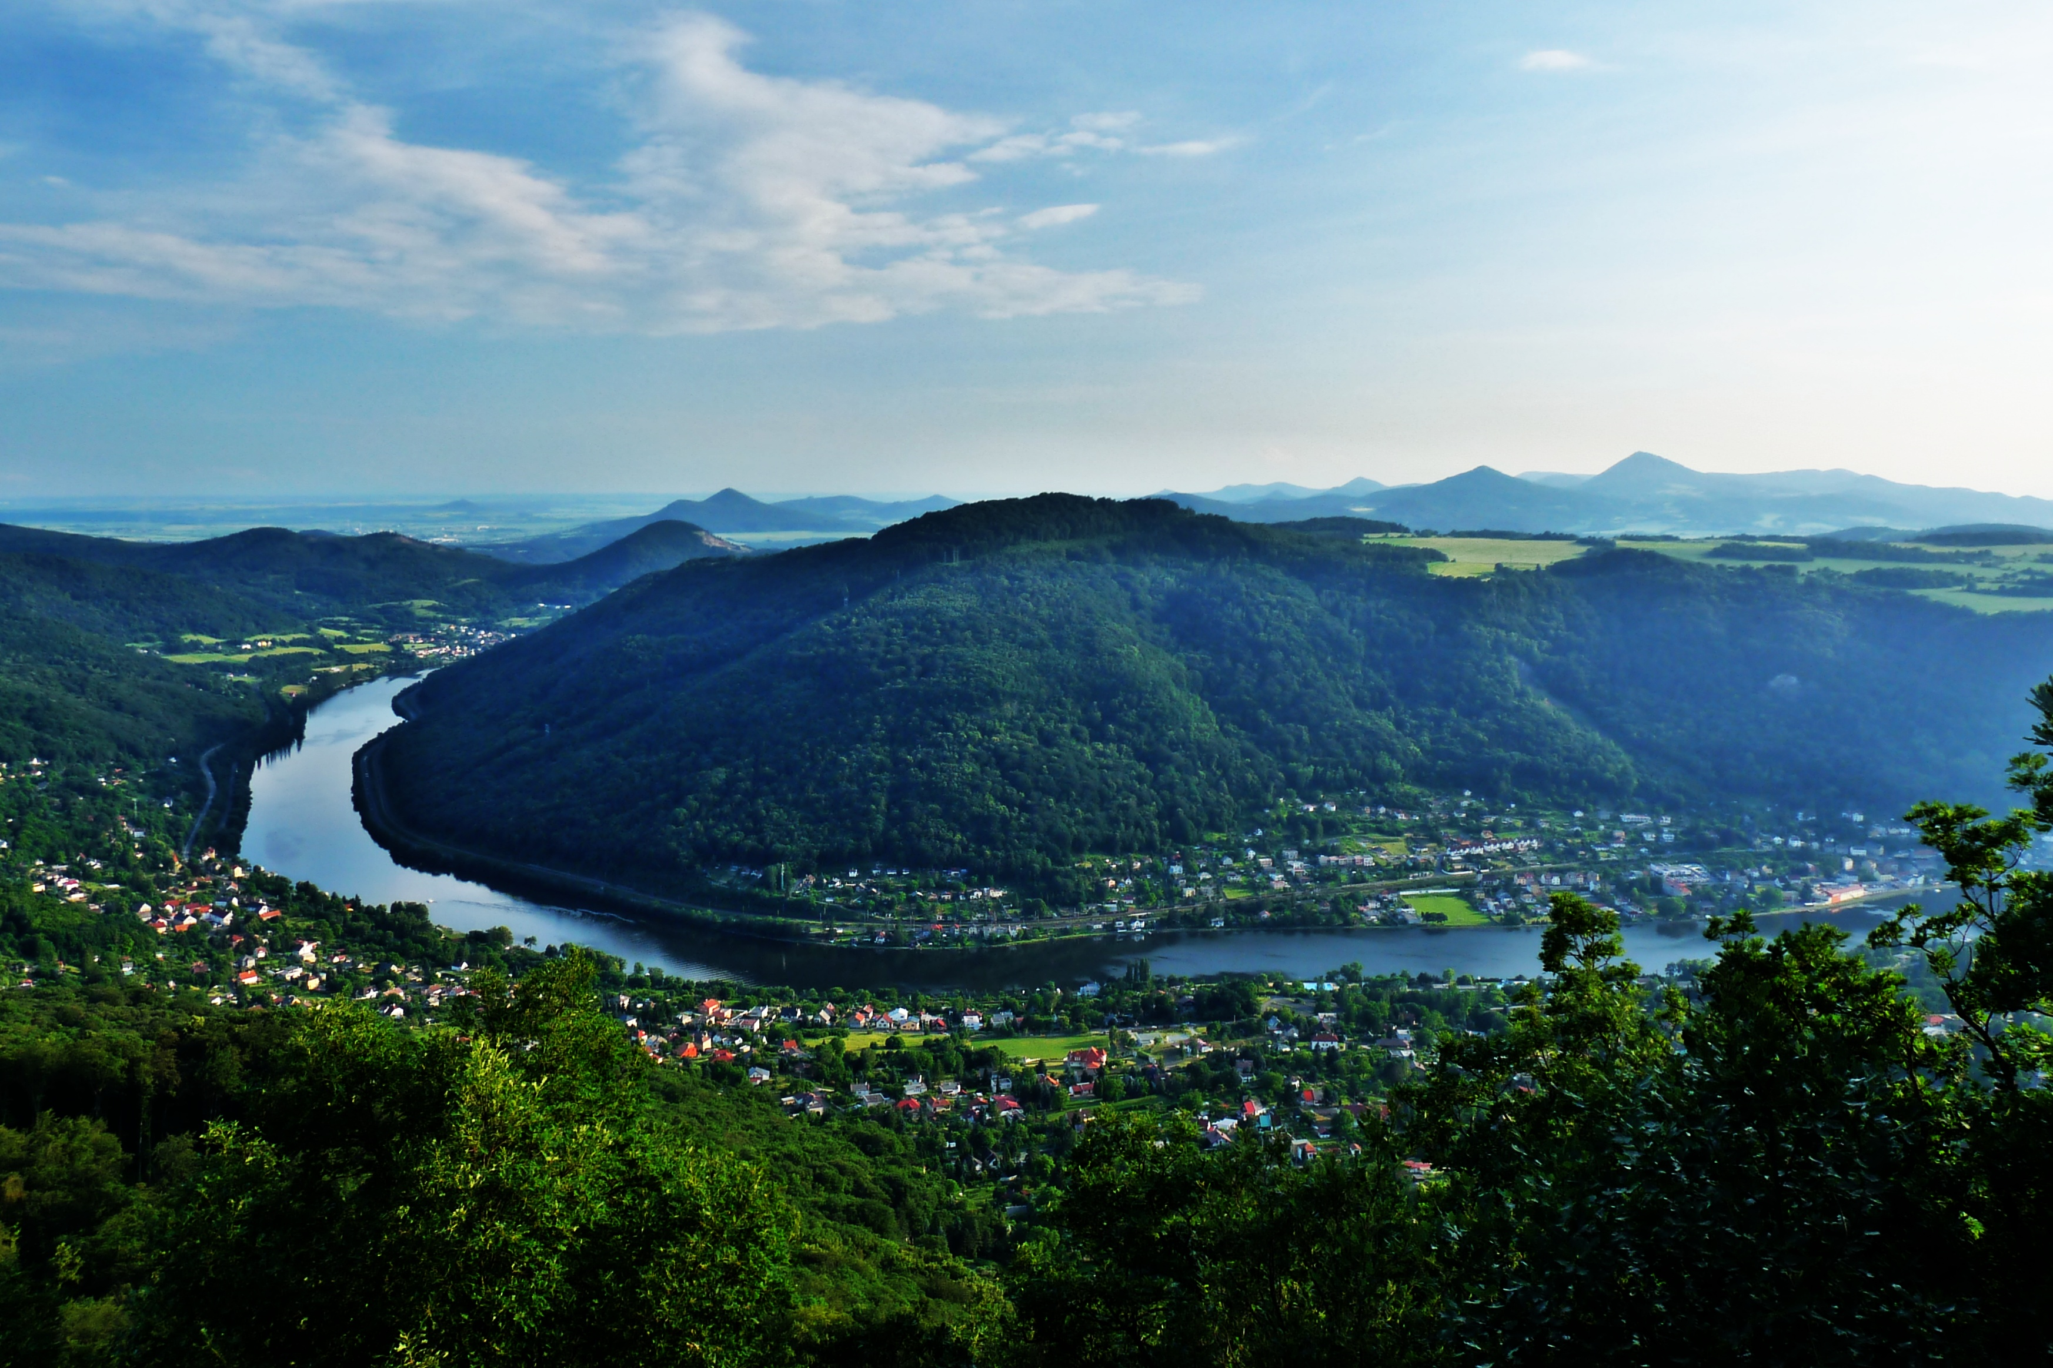
Region Ústí nad Labem
Situated along the Czech largest river, Labe (Elbe).
Beautiful and almost magical surroundings including post-volcanic landscape of the Bohemian Central Mountains, the dramatic sandstone canyons of Bohemian Switzerland, the rugged Ore Mountains and the green Hills of Lusatian Mountains.

Slide 6

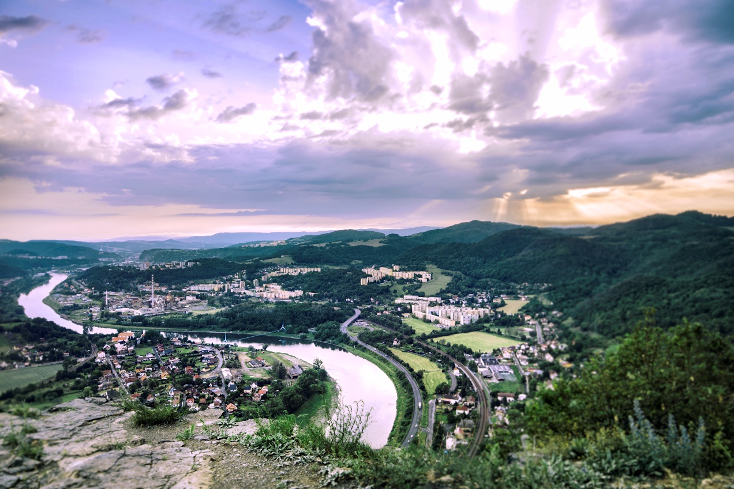
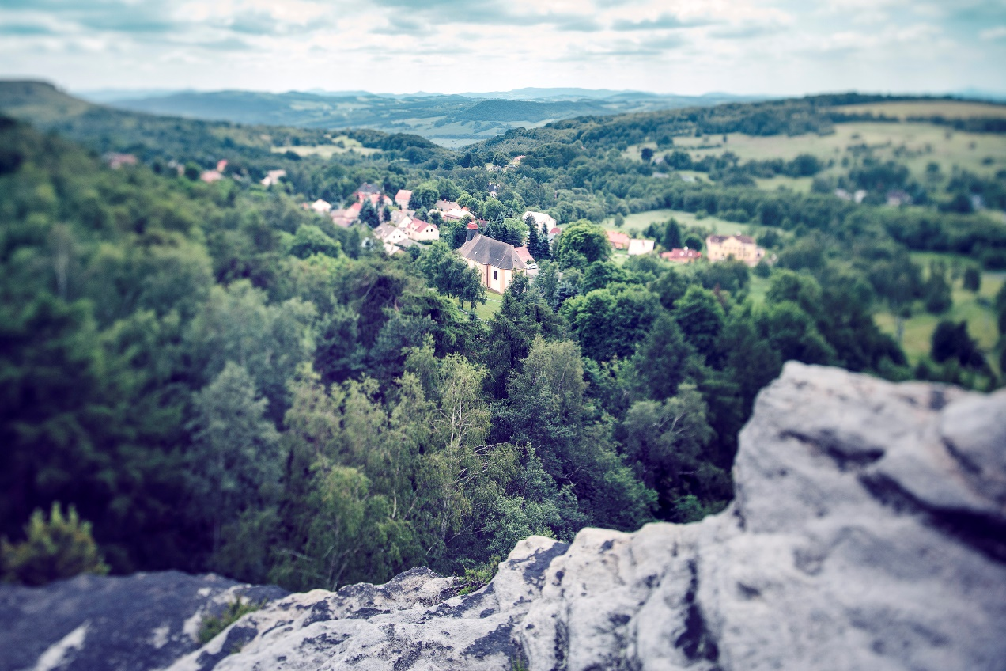

Slide 7
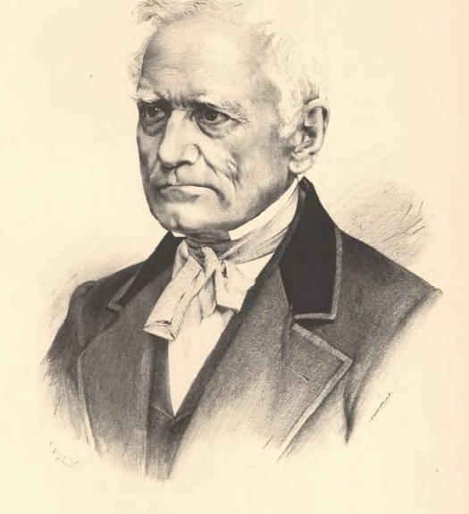
J. E. Purkyně
Jan Evangelista Purkyně (1787–1869), after whom the university is named, was born nearby in a small town Libochovice. He was a Czech physiologist, anatomist, biologist, poet and philosopher. Furthermore, he was a devoted patriot.
Today, Purkyně is considered to be one of the founders of cytology (the discipline of biology focused on cells).

Slide 8
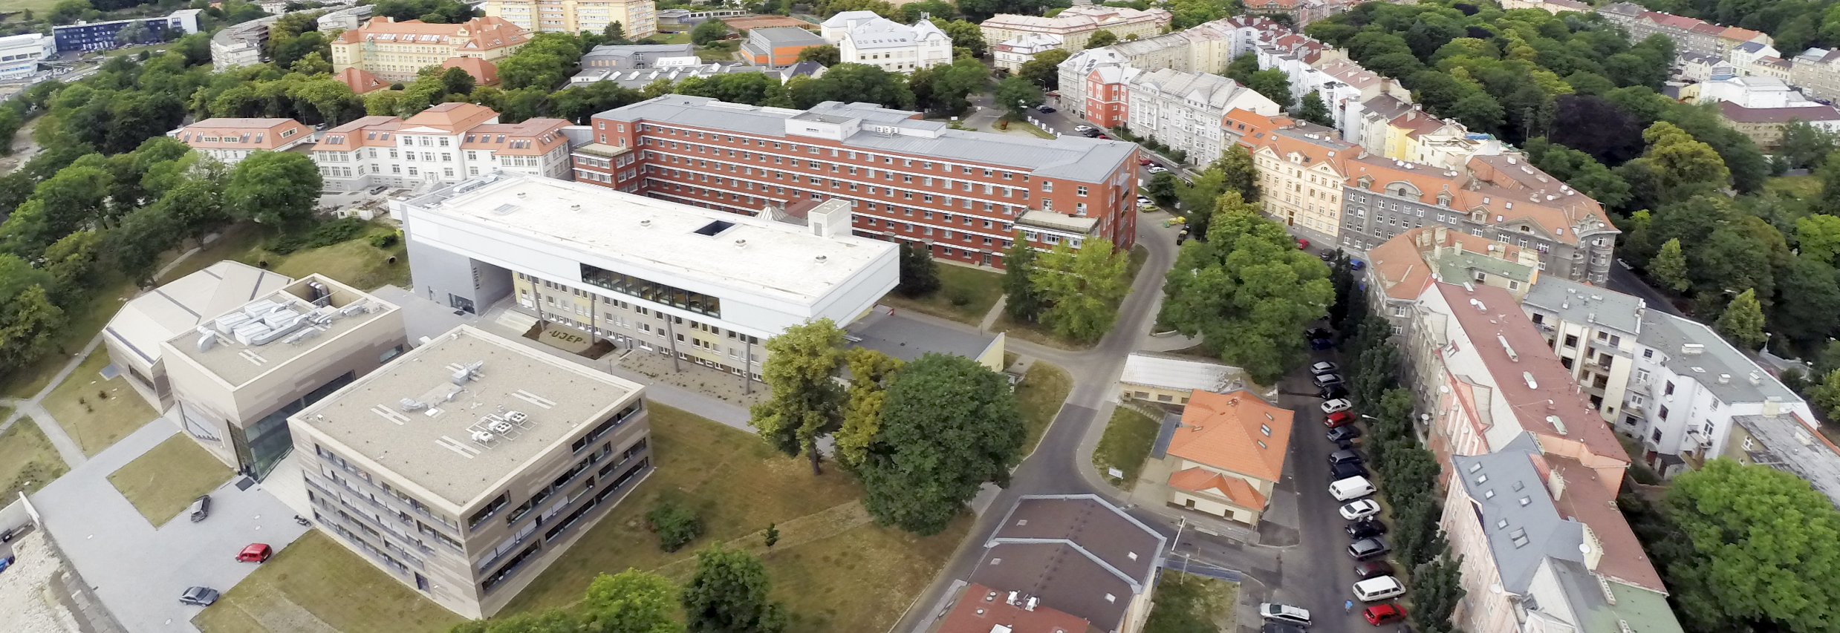
8
History
of our university
1954
1959
1964
1991
University was founded
Faculty of Education
Faculty of Environment
Faculty of Social and Economic Studies
Institute of Slavonic & Germanic Studies
Higher Teacher Training College
Pedagogical Institute
Faculty of Education

Slide 9
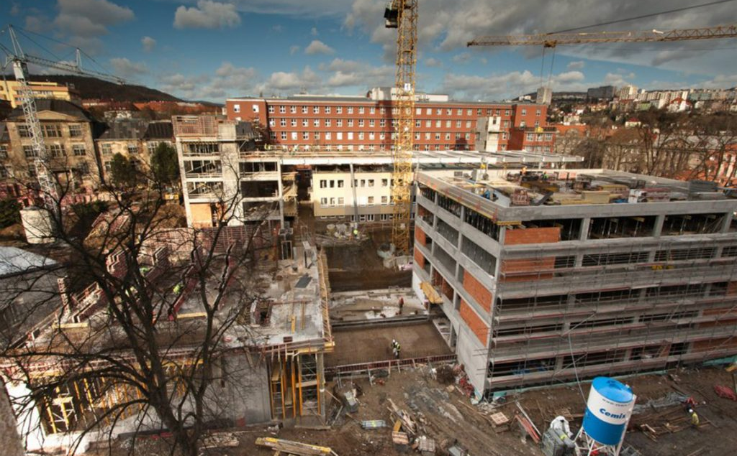
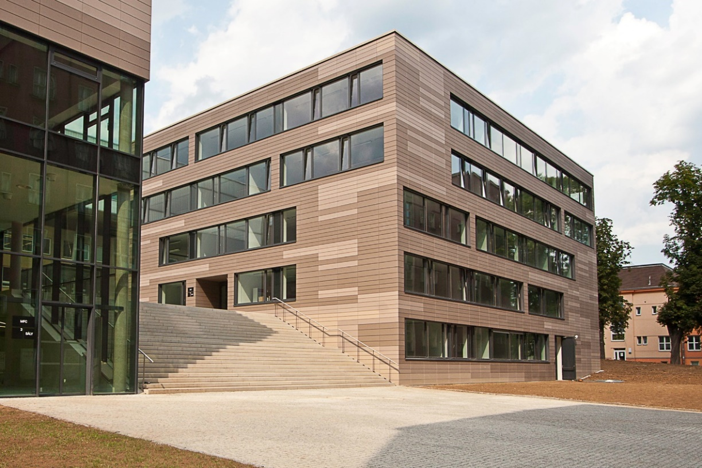
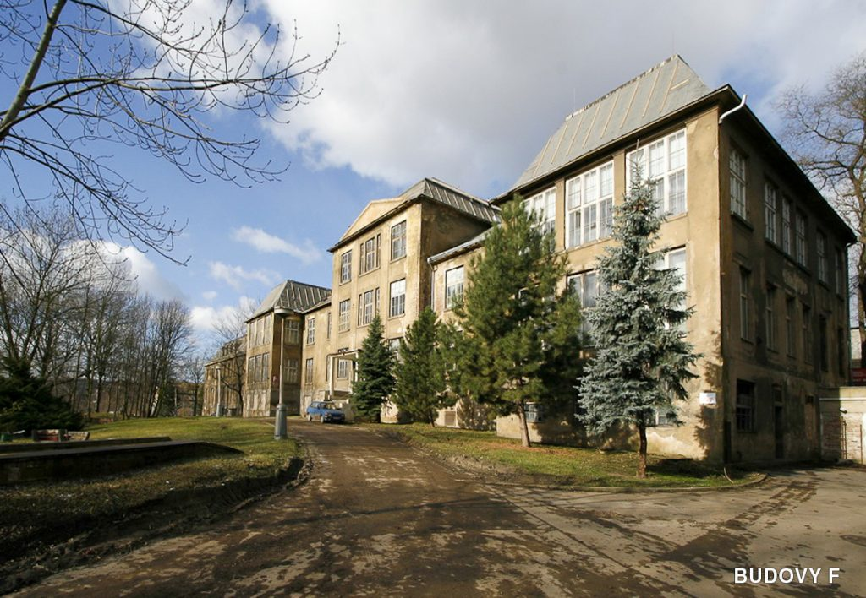
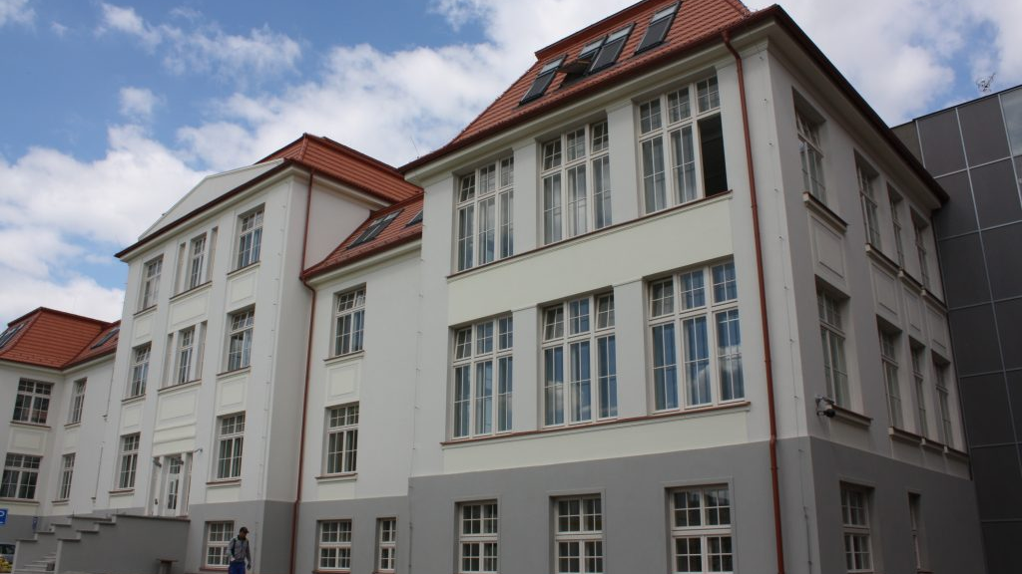
UJEP‘s transformation

Slide 10
10
University today
Faculty of Mechanical Engineering
Faculty of Environment
Faculty of Art and Design
Faculty of Arts
Faculty of Health Studies
Faculty of Science
Faculty of Education
Faculty of Social and Economic Studies

Slide 11
Facts and figures
Established: 1991
Faculties: 8
Students: 8 thousands
M/F ratio 35% : 65%
foreign students 4%
Academic staff: 583
Technical and administrative staff: 509
Student-teacher ratio: 14:1
Full-time study programmes: 191
Part-time study programmes: 127

Slide 12
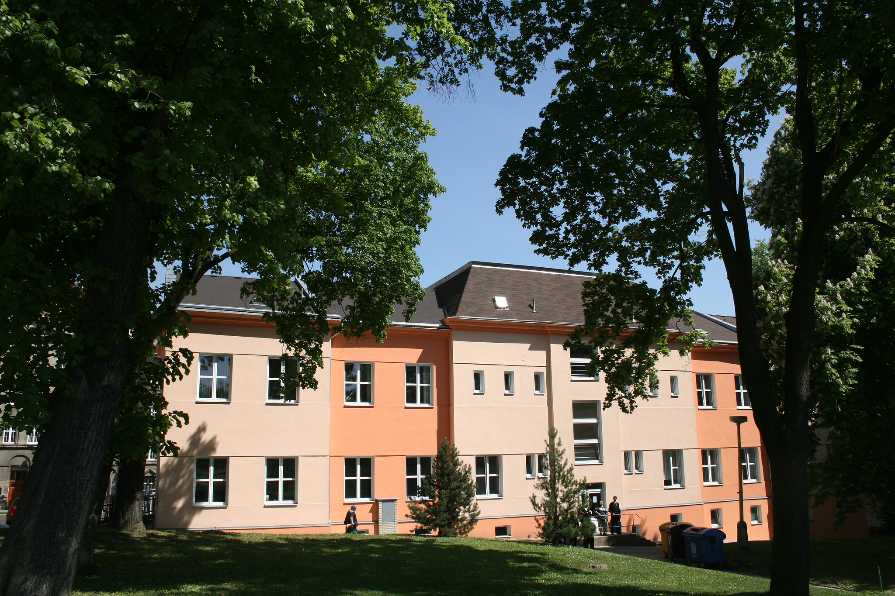

12
Faculty of Mechanical Engineering
Faculty of Mechanical Engineering prepares future experts for various industrial branches, such as engineering, technology, energetics and material engineering.

Slide 13
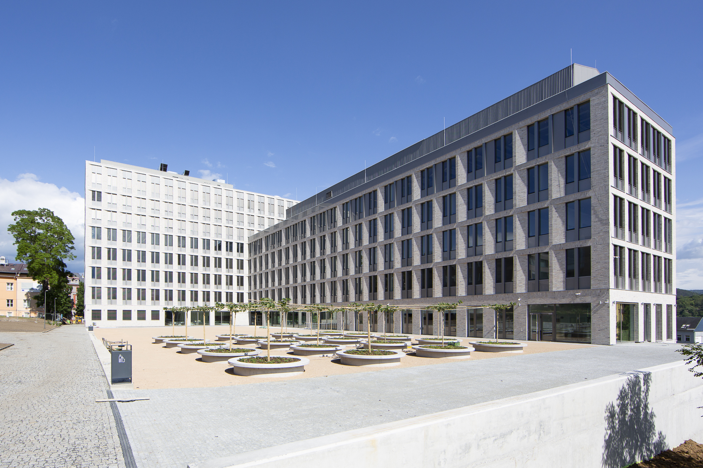

13
Faculty of Environment
Faculty of Environment focuses on ecology and problems connected with
a human interaction with nature.

Slide 14
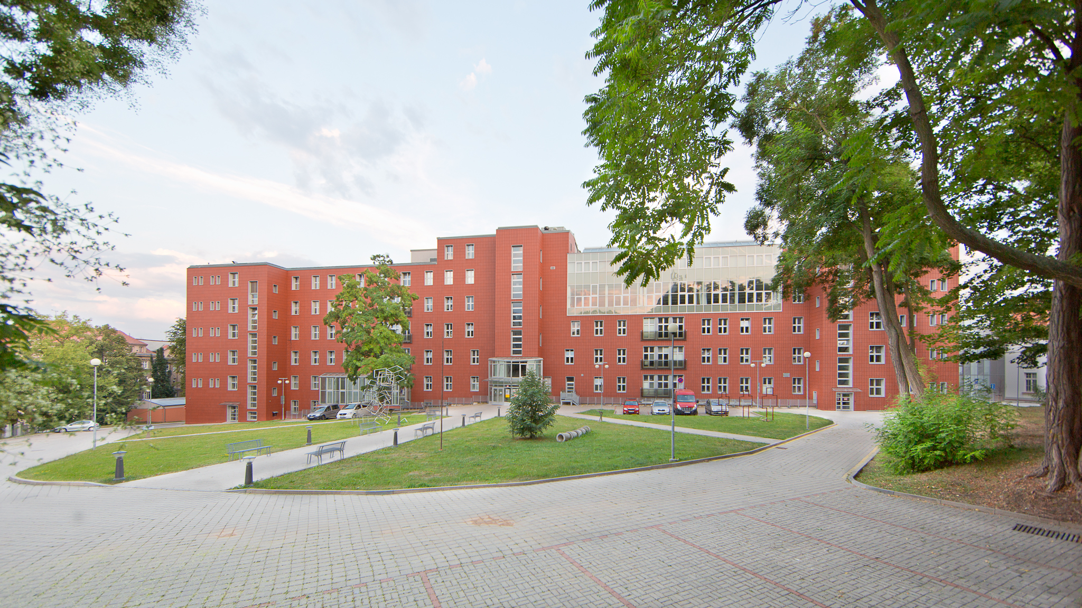

14
Faculty of Art and Design
Faculty of Art and Design offers complex education in various specializations focused on art and design.

Slide 15
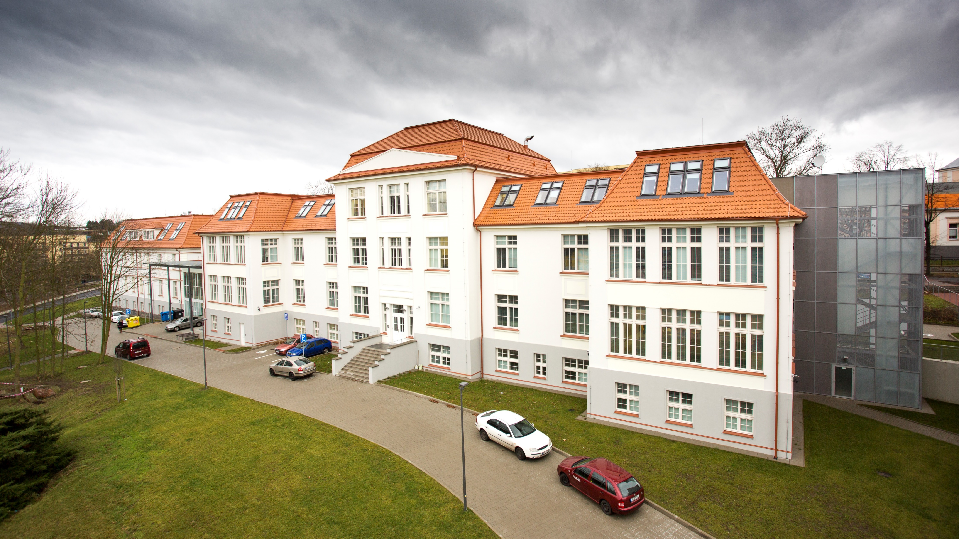

15
Faculty of Arts
Faculty of Arts is focused on education and research in the humanities, such as political studies, history, philosophy and German language.

Slide 16
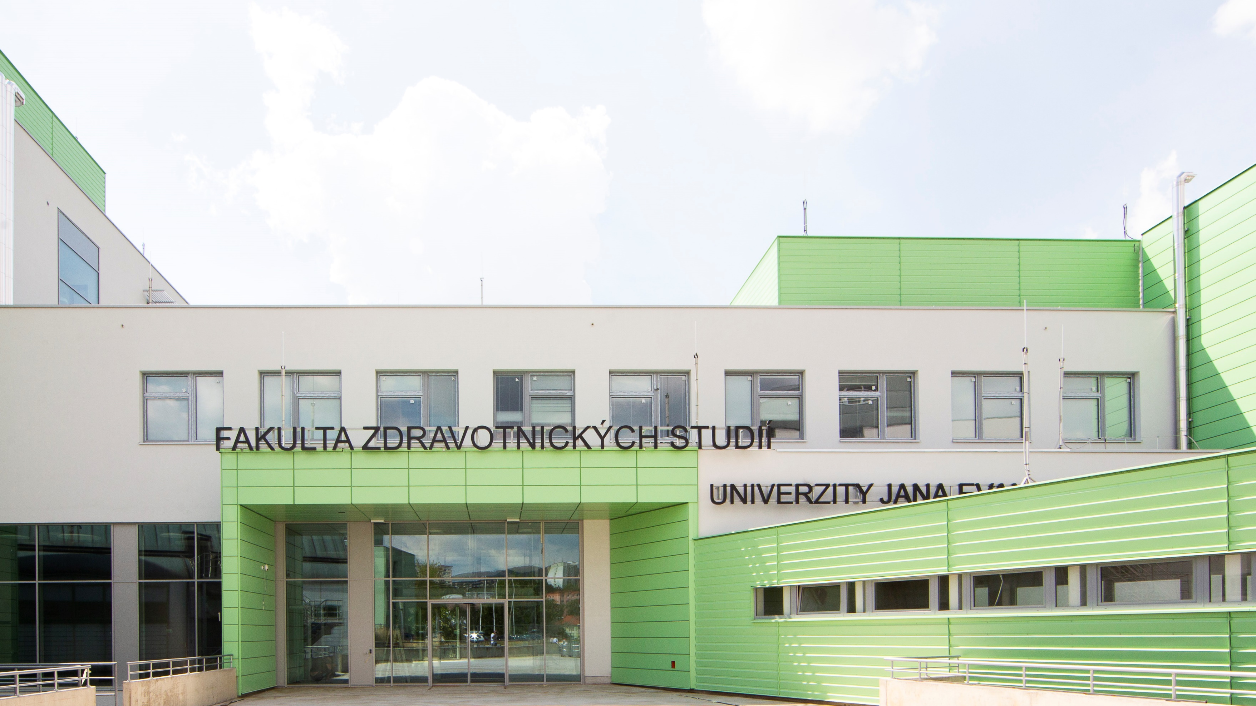

16
Faculty of Health Studies
Faculty of Health Studies educates students in non-medical health fields, such as physiotherapy, occupational therapy, general nursing and midwifery.

Slide 17
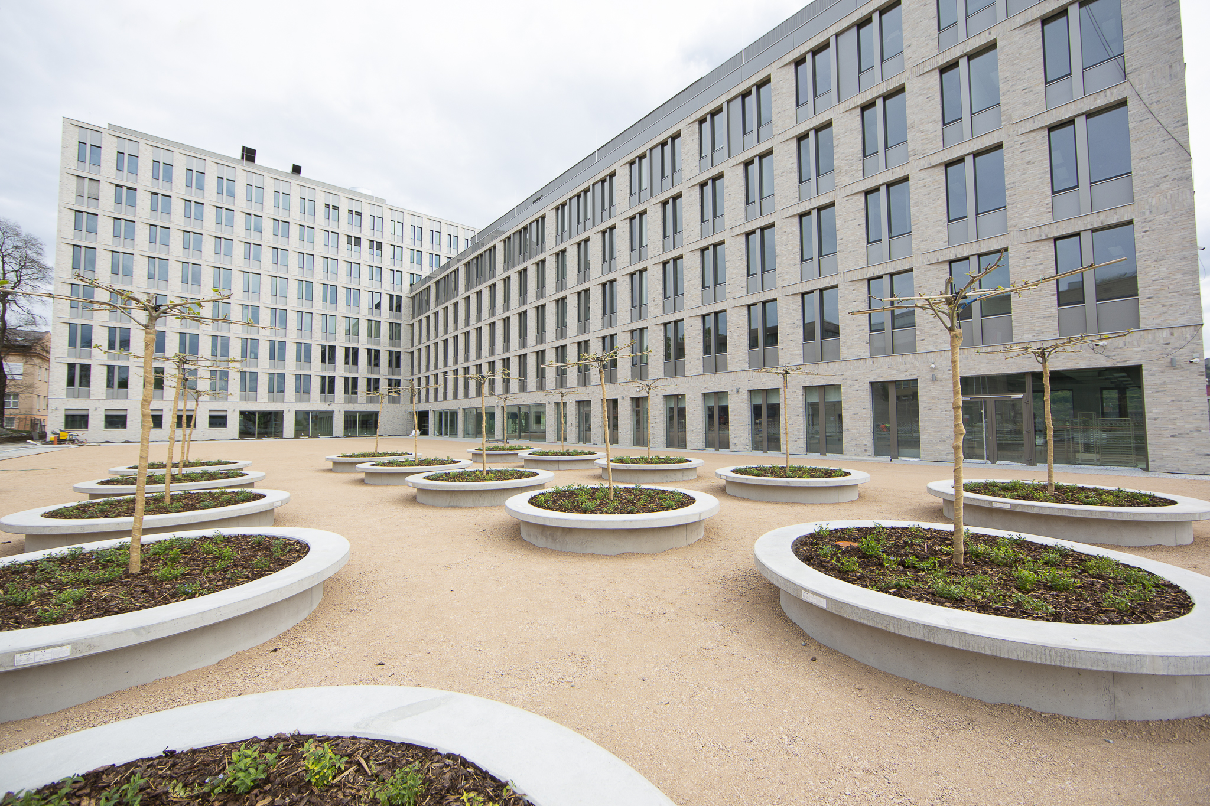

17
Faculty of Science
Faculty of Science focuses on knowledge and education in all nature sciences, with a strong emphasis on scientific progress in each discipline.

Slide 18
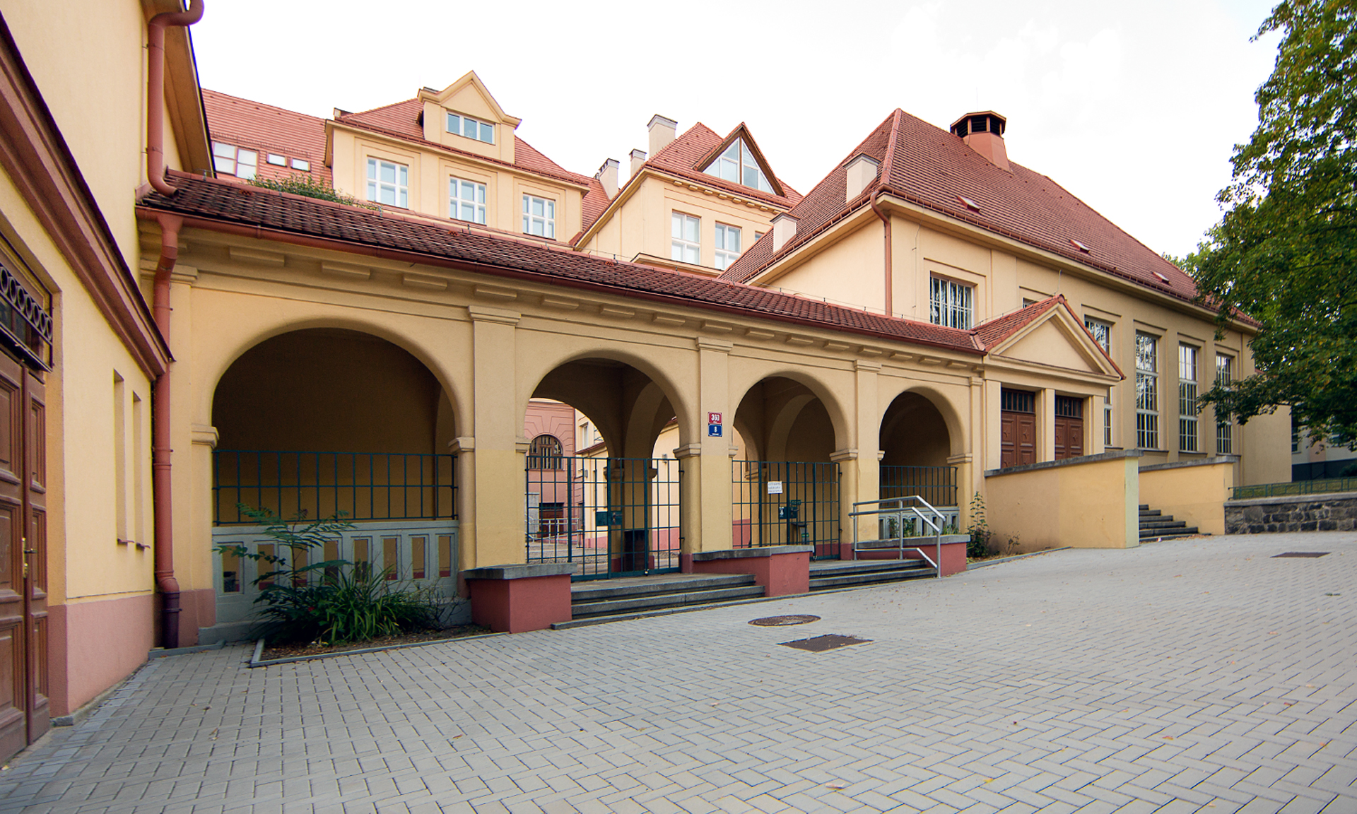

18
Faculty of Education
Faculty of Education focuses on preparation of prospective teachers and other experts in the field of education, ranging from kindergarten to university and other
leisure-time activities.

Slide 19
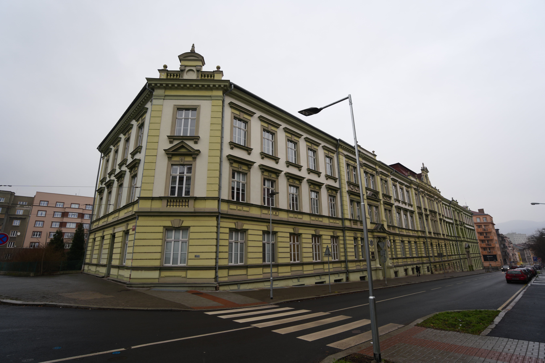

19
Faculty of Social and Economic studies
Faculty of Social and Economic Studies prepares highly qualified economists and managers in various social spheres.

Slide 20
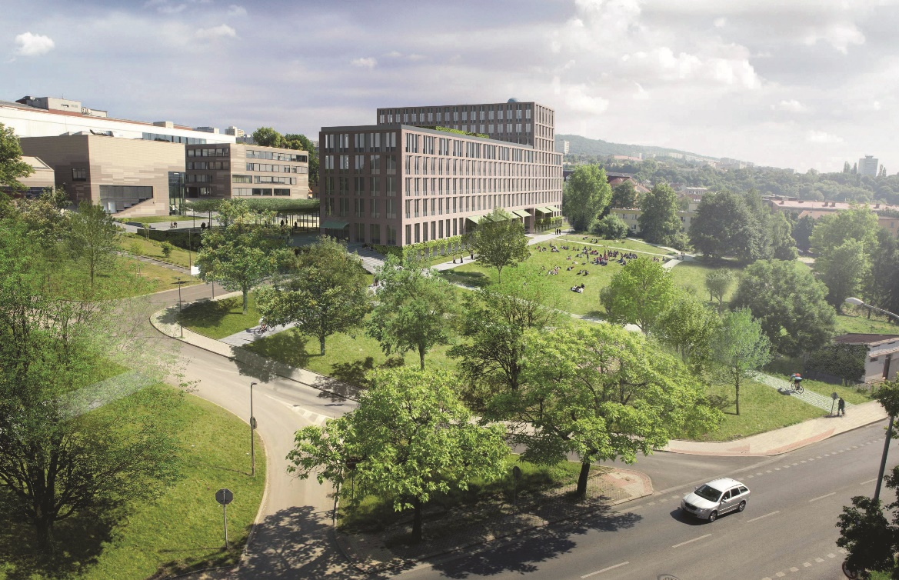
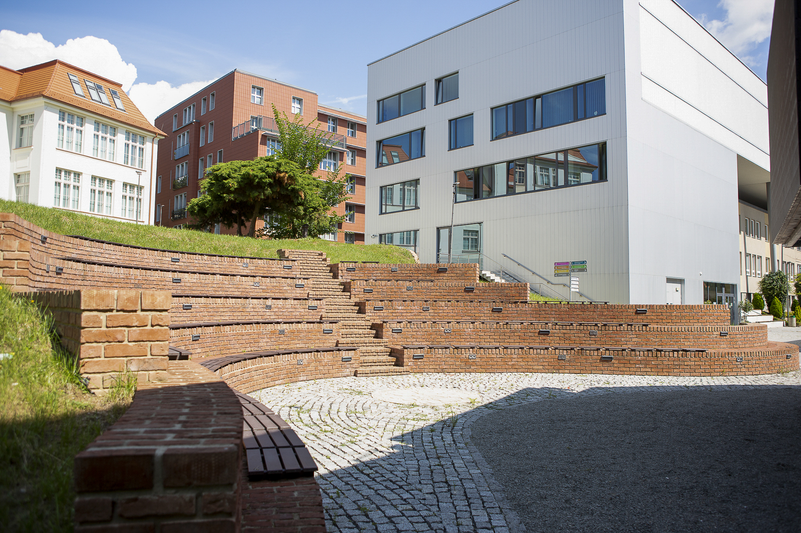
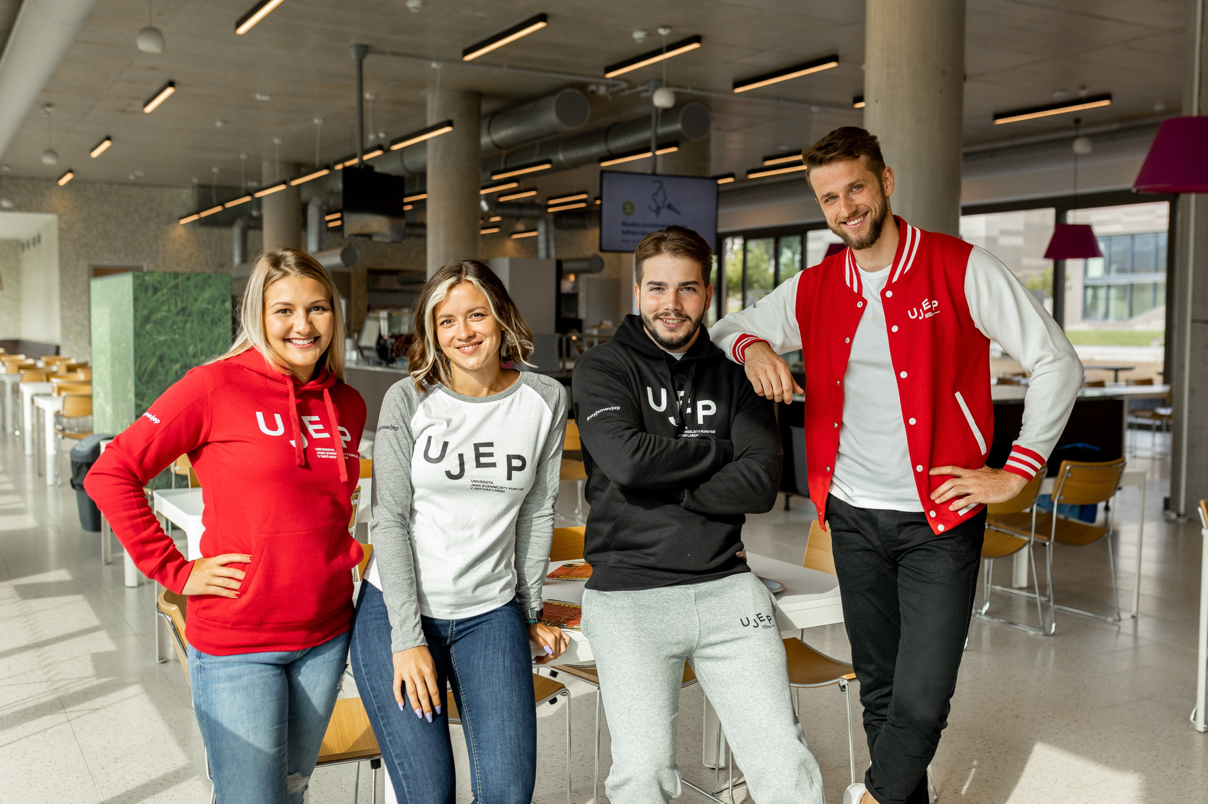

Our campus

Slide 21
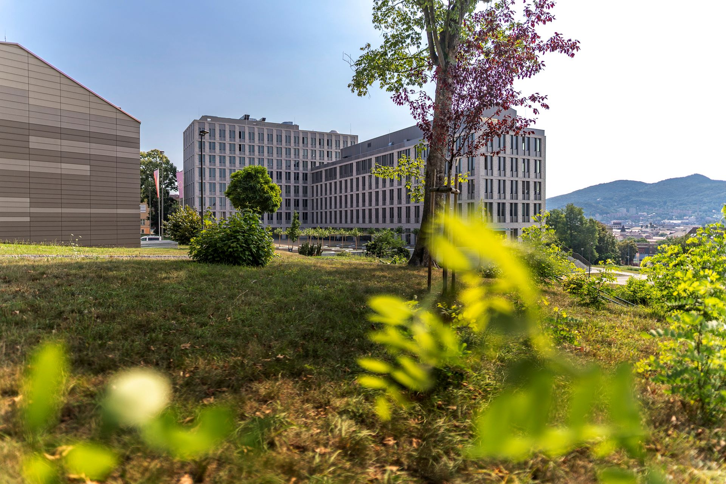
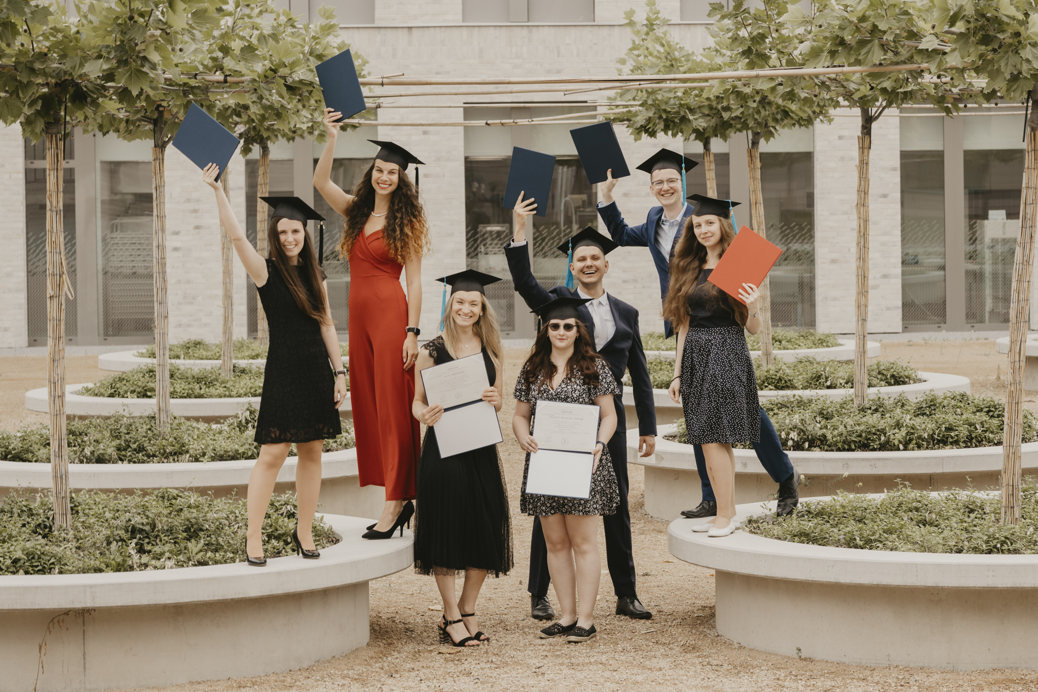
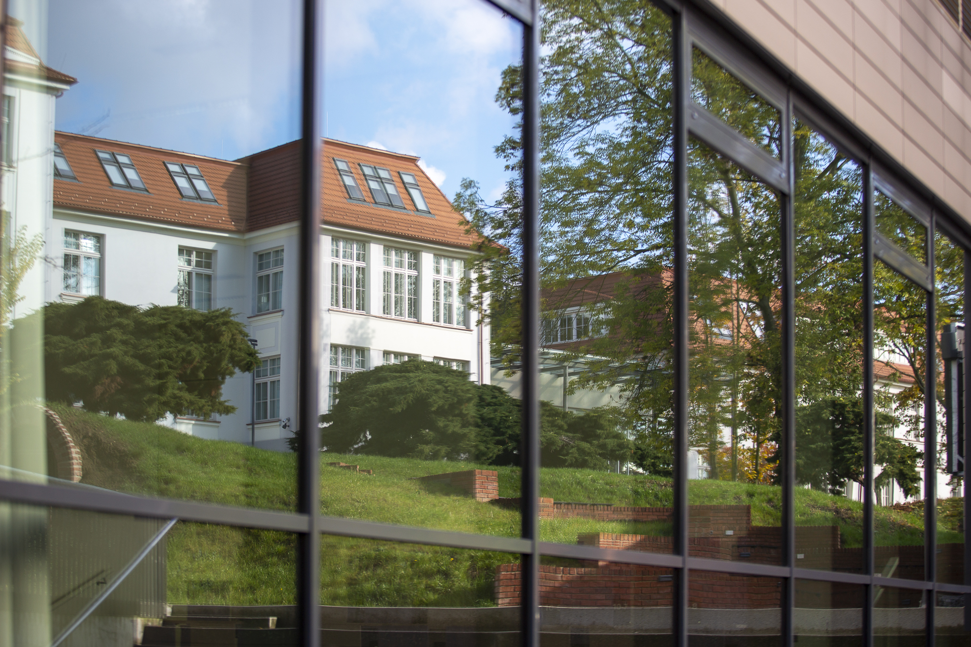
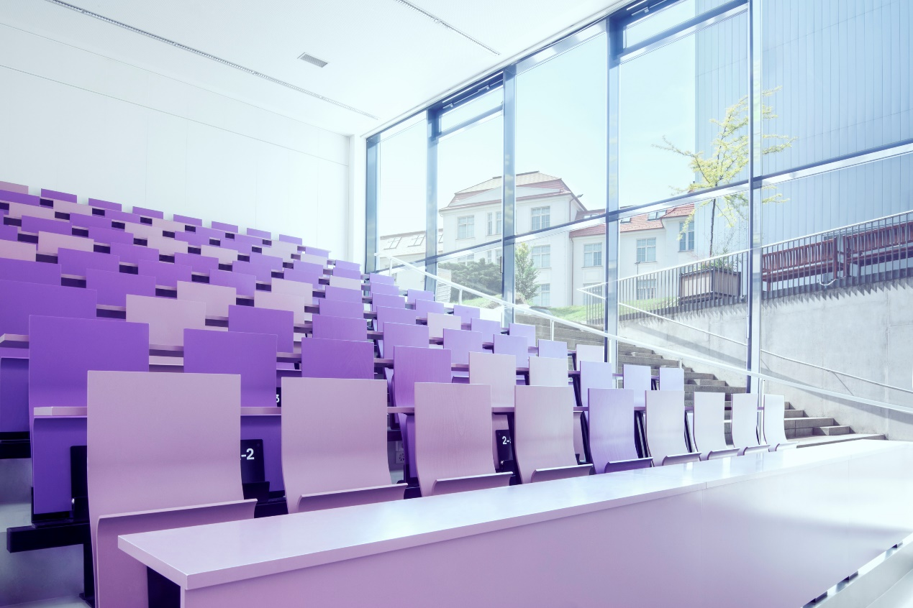
Our campus

Slide 22

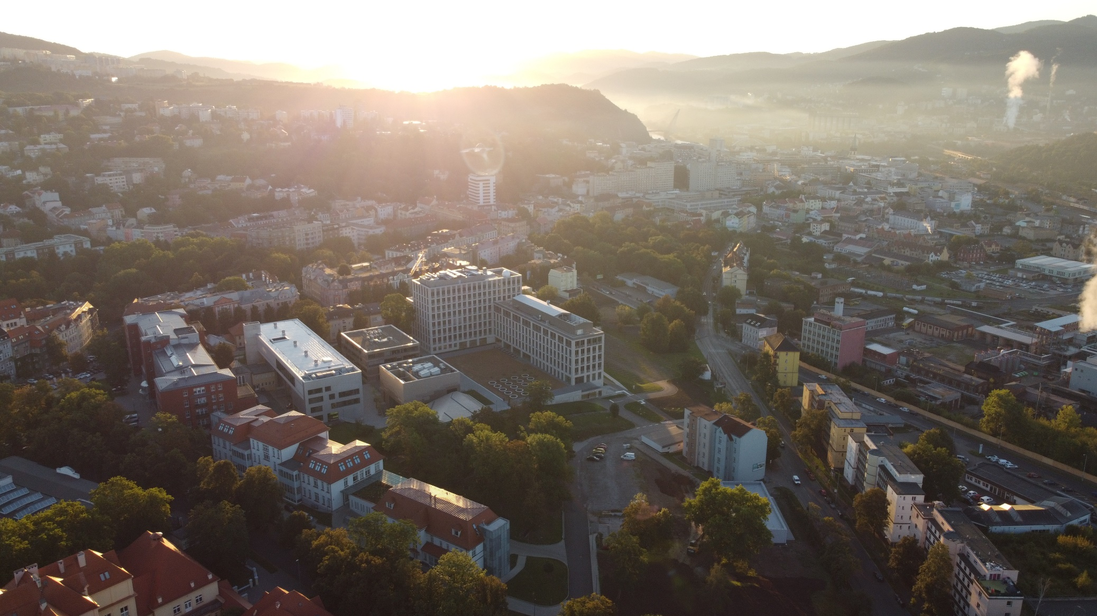
Campus from an aerial perspective

Slide 23
Study programmes and courses
in the Czech language
in foreign languages
in the English language for ERASMUS students
Bachelor
(Bc., BcA.)
Master
(Mgr., MgA., Ing.)
Doctoral
(Ph.D.)
Fine Art (Photography)
(MgA.) – FUD
Geographies of Transformations
(Ph.D.) – PřF
Computer Modelling in Science and Technology (Ph.D.) – PřF
Landscape Reclamation and Ecosystem Services (Ph.D.) – FŽP
Interkulturelle Germanistik (NMgr. Double Degree with Bayreuth Uni) – FF
Our university also offers a large number of courses on all faculties to ERASMUS+ programme students.

Slide 24
Number of our students and graduates from 2005 to present
Number of students
Number of graduates

Slide 25
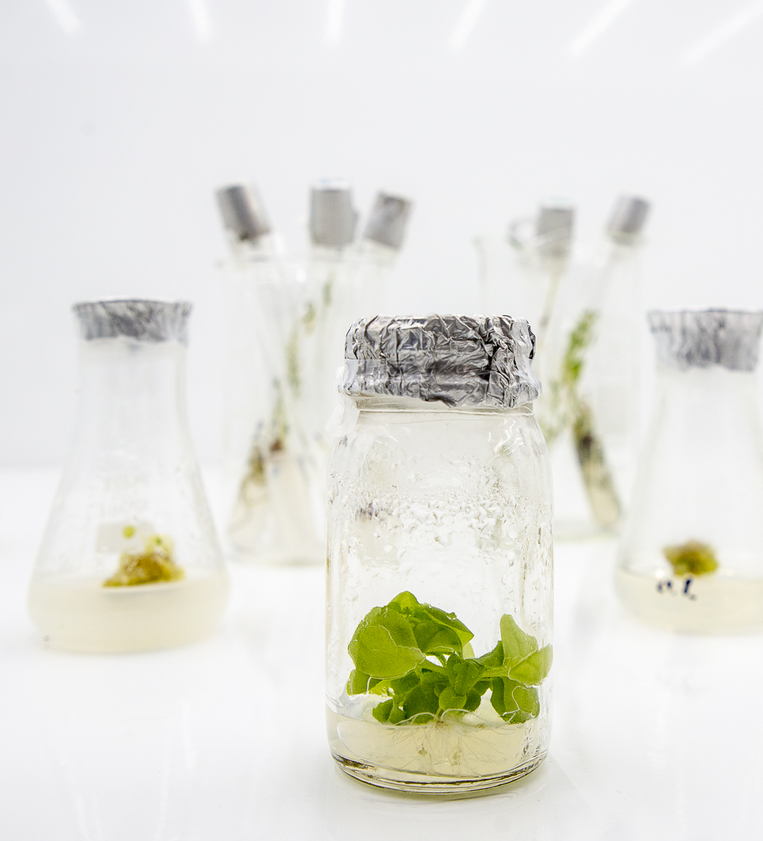
Science & Research
The University of Jan Evangelista Purkyně participates in many projects focused on the development of science and technology, and on improving the quality of life in our region.

Slide 26
Science & Research
Research clusters
Material sciences and Biotechnology
Environmental sciences and Regional studies
Health sciences, Cognitive and Behavioural studies
Heritage studies, Cultural and Creative industries
Educational research and Social work
Environmental engineering, Energy research and Natural Sciences
Media and communications and Interdisciplinary research

Slide 27
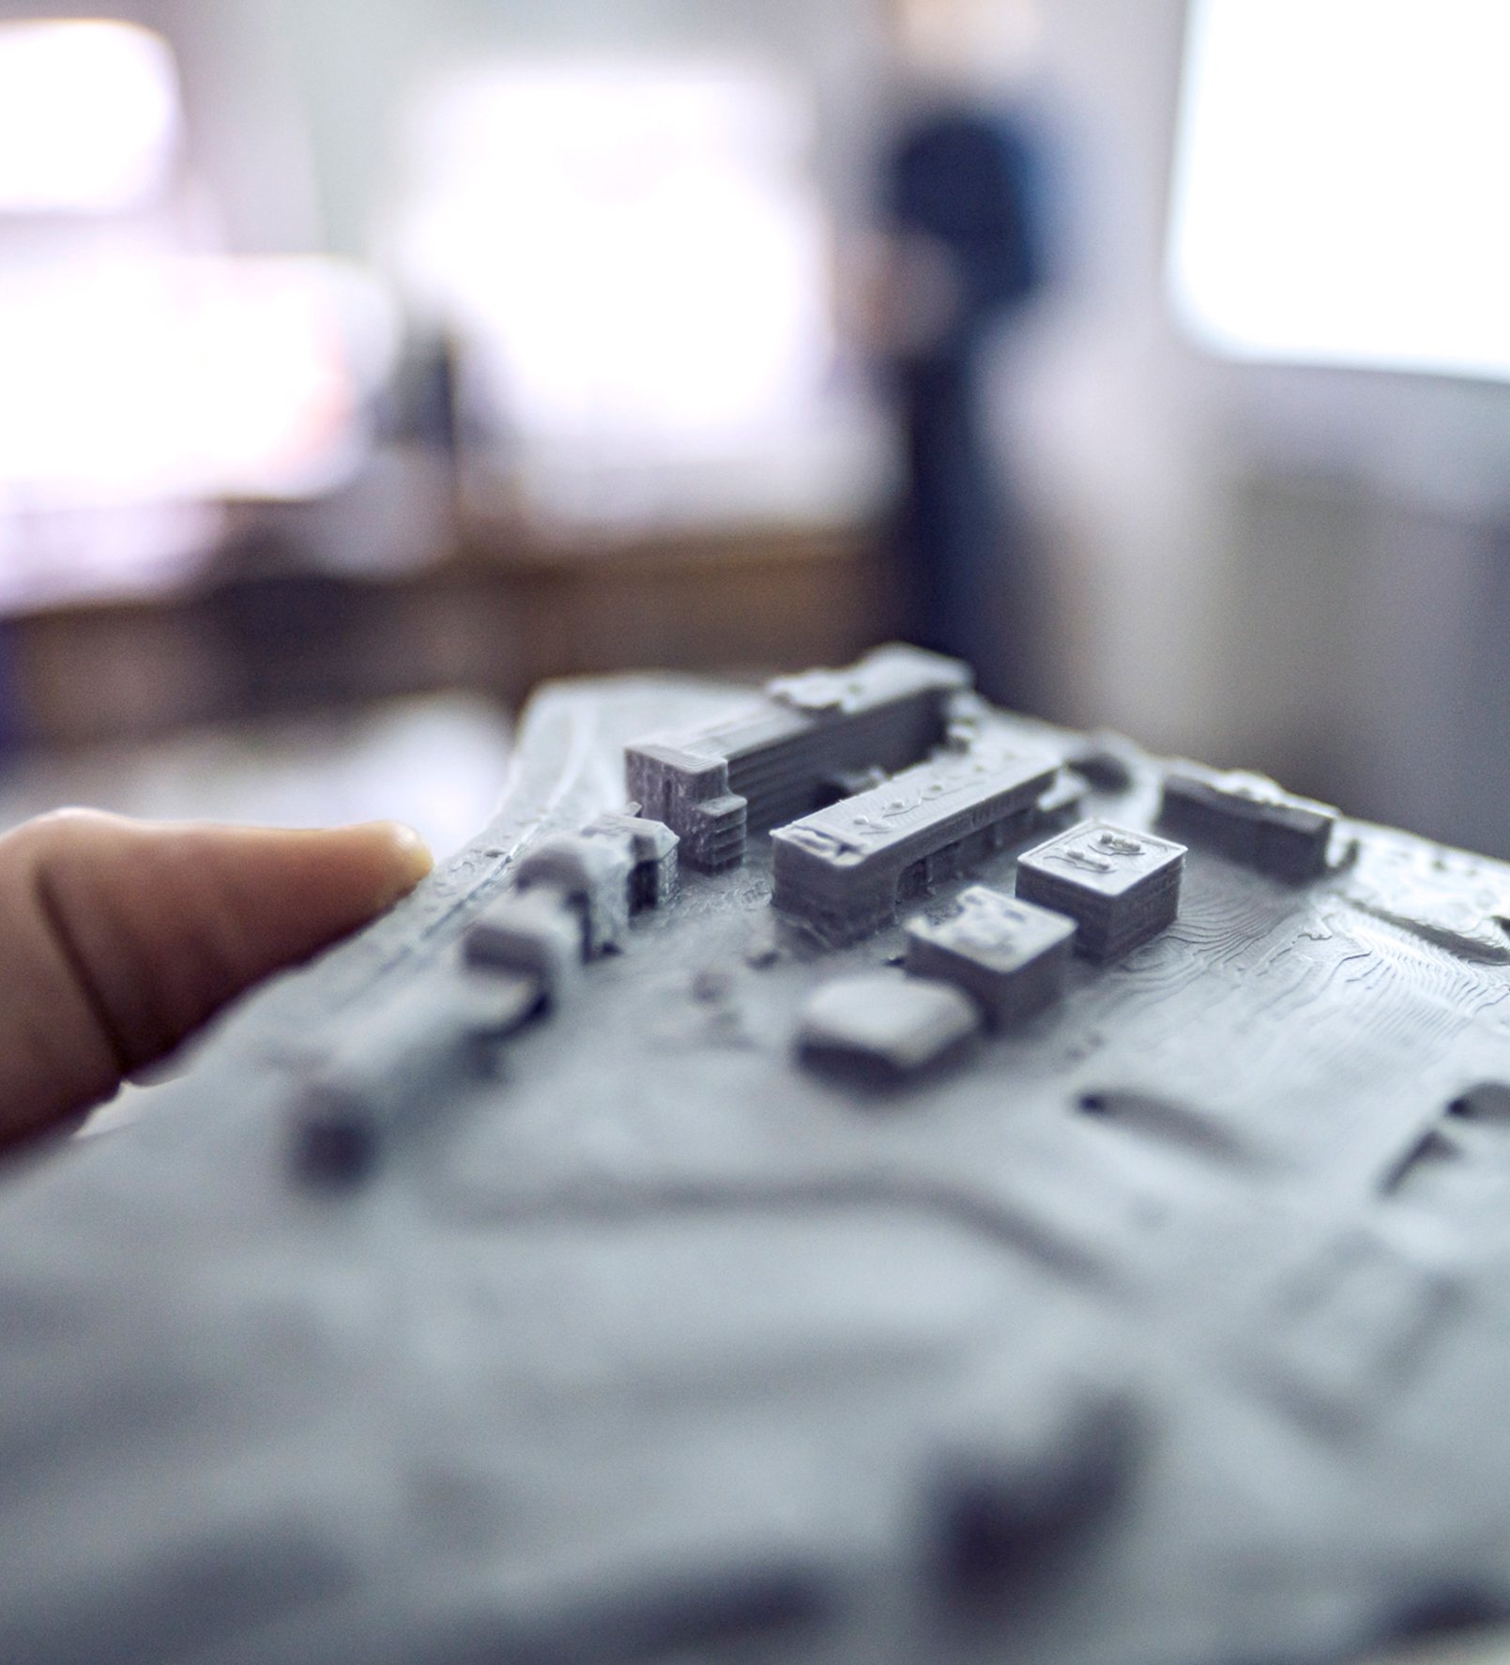
Science & Research
Project MATEQ
A research project focused on real applications in biomedicine, chemical industry, renewable resources, supporting our environment and enhancing quality of life.
Project Smart City – Smart Region –
Smart Community
A complex view of the creation of high-quality living conditions and infrastructure for succesful living, in order to overcome social problems
in a society.

Slide 28
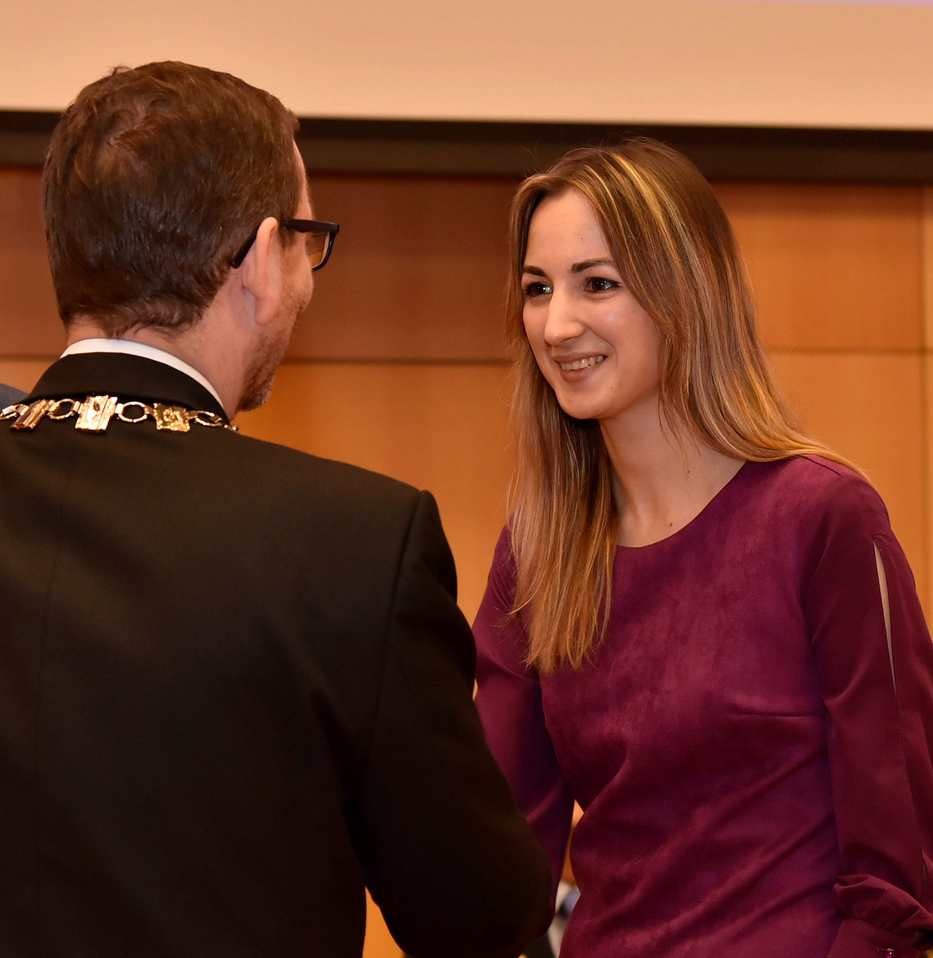

We are the proud recipient of a renowned HR Award
The HR Excellence in Research Award (HR Award) is a prestigeous award given by the European Commitee for excellent performace in HR care in a scientific environment. For any researcher, us having this award is a guarantee of European standards when it comes to caring about our employees, transparency in tenders, openness to the public, and high quality of work environment.

Slide 29
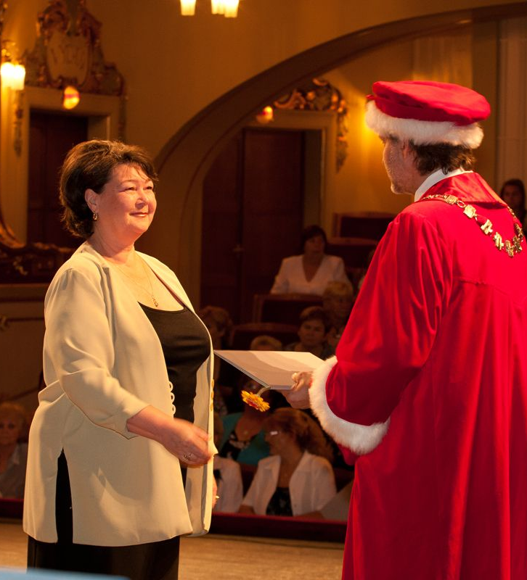
U3V
The Third Age University
The Third Age University (U3V) is a specific form of lifelong learning organized by us as a result of our membership in the Association of the Third Age Universities in an agreement with the the Charter of Rights and Freedoms, and also with our status from the academic year 1994/1995.

Slide 30
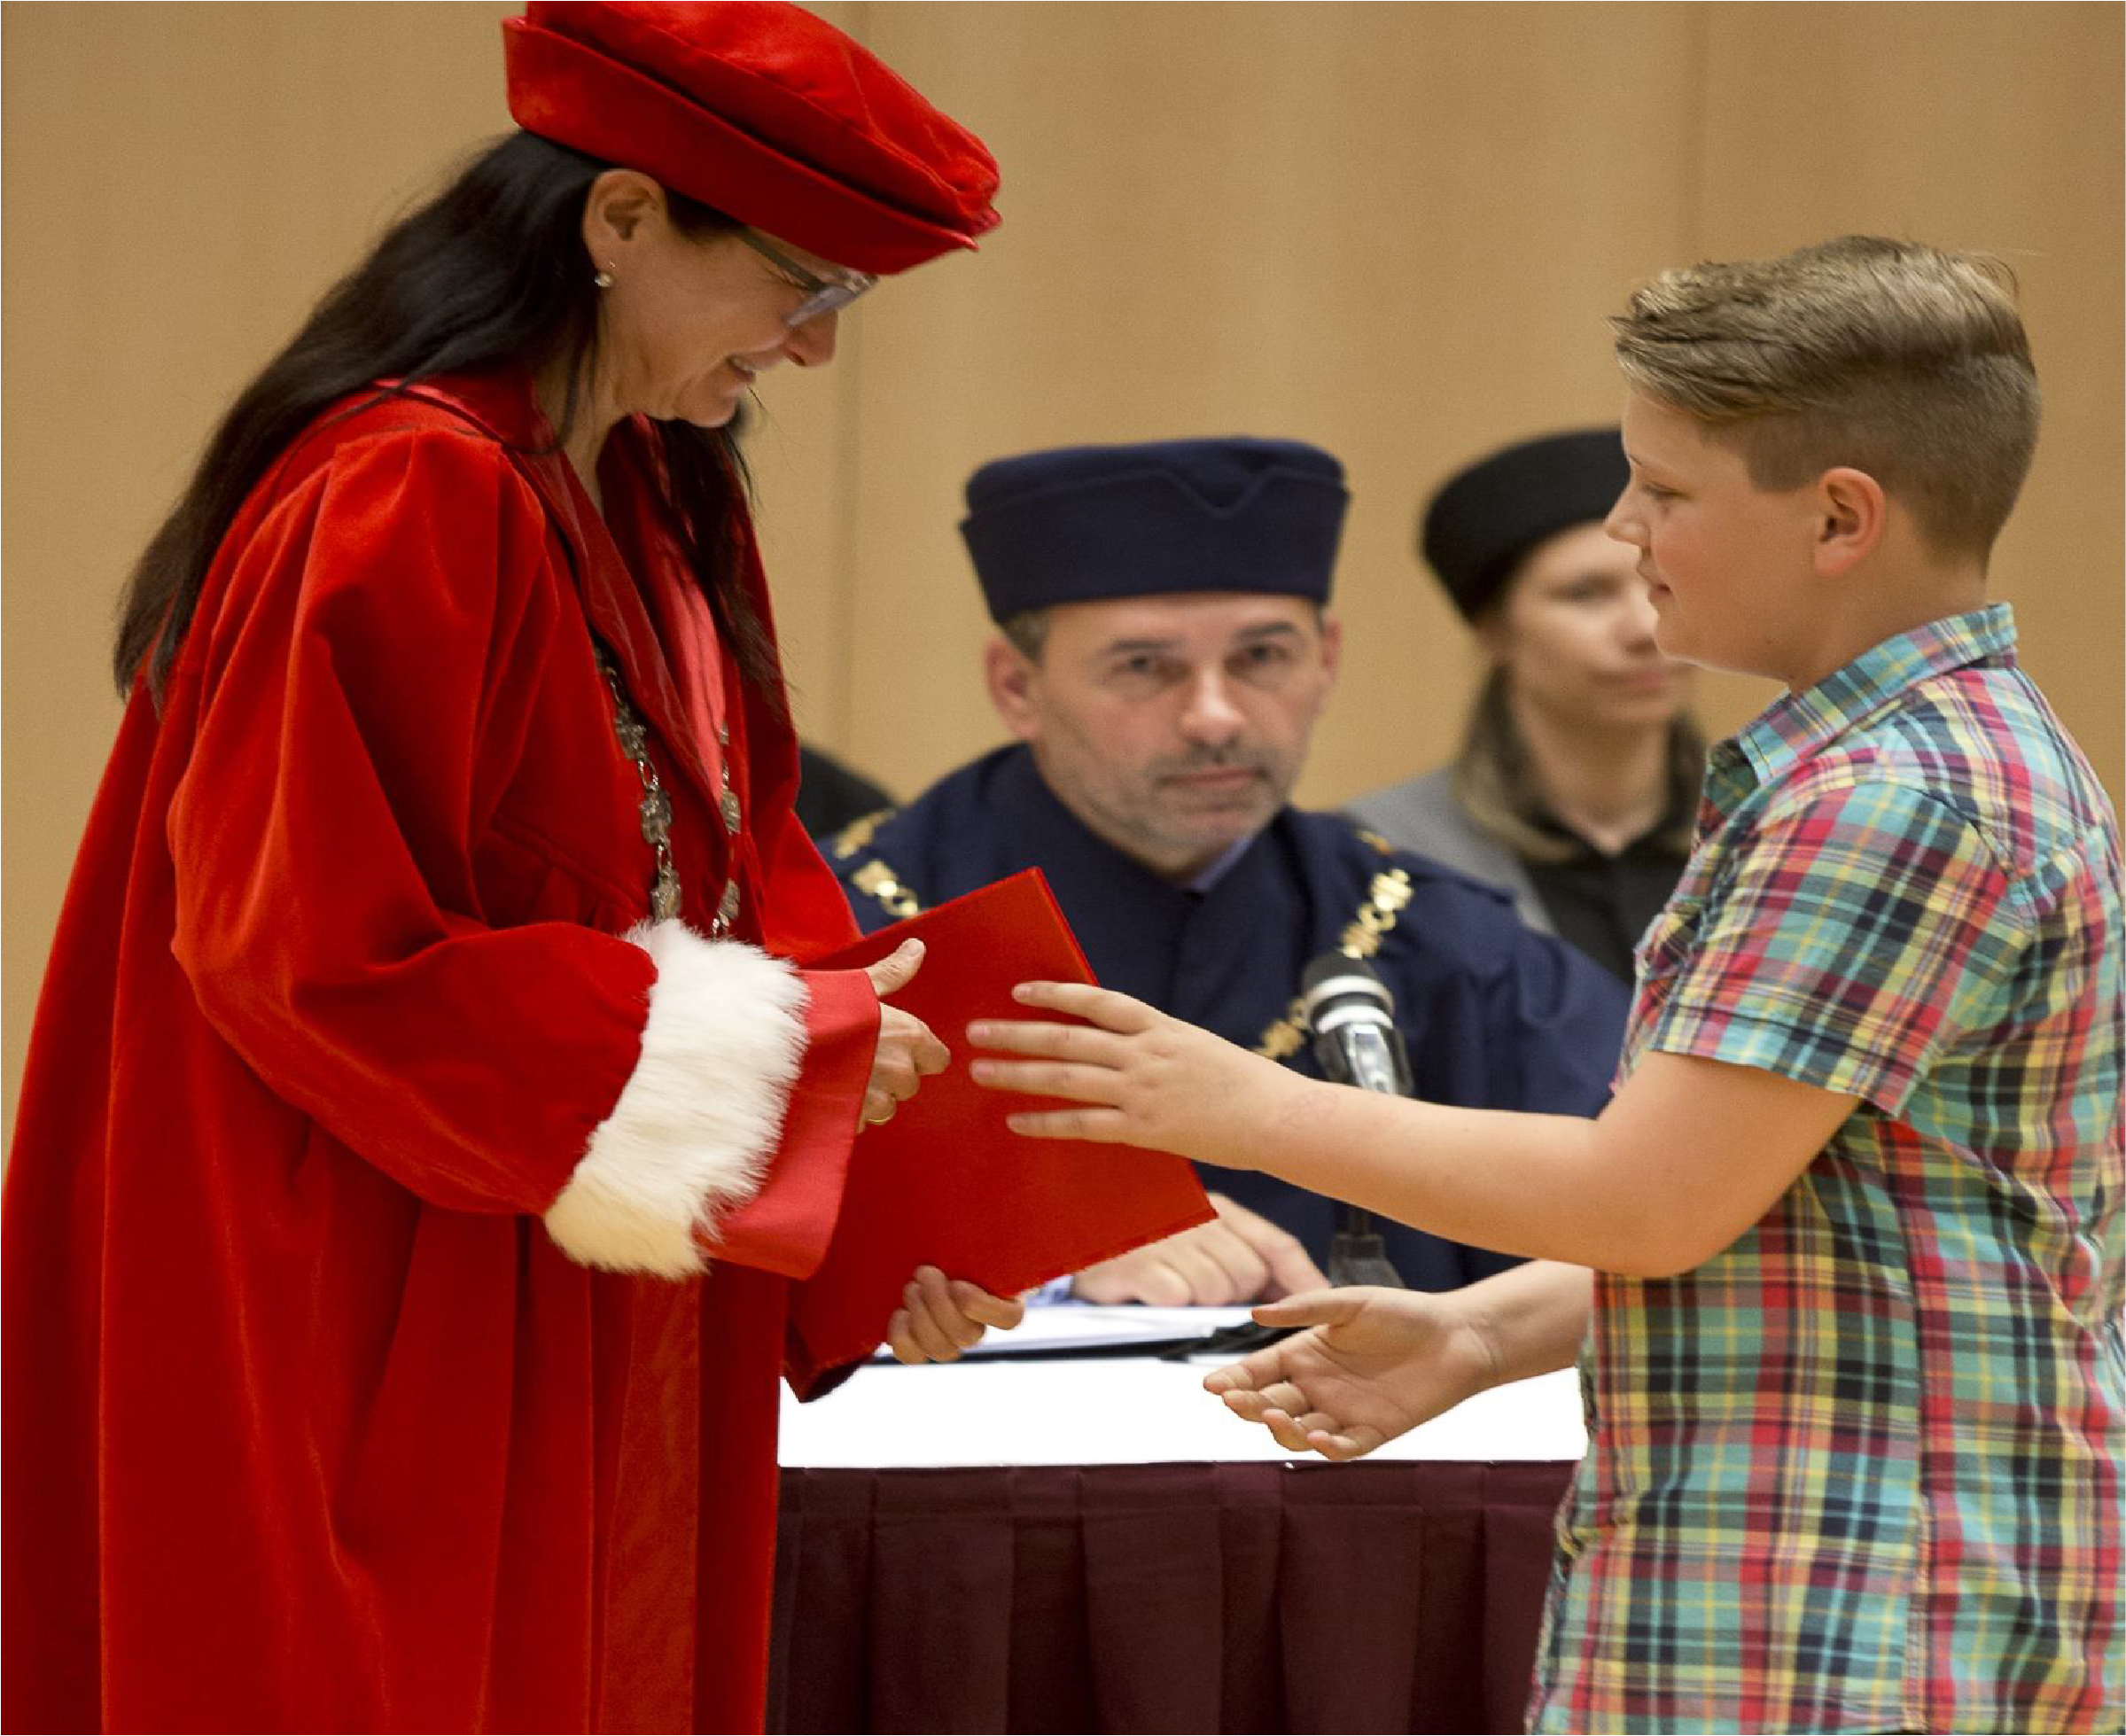
TAU
Teen Age University
Our university also organizes the Teen Age University, a two-semester long course for elementary school pupils aged 7 to 12 years old. They are taught by university teachers, who help these bright young minds to enter new spheres of knowledge in various scientific areas.
The Teen Age University UJEP has been organised annually ever since 2009.

Slide 31
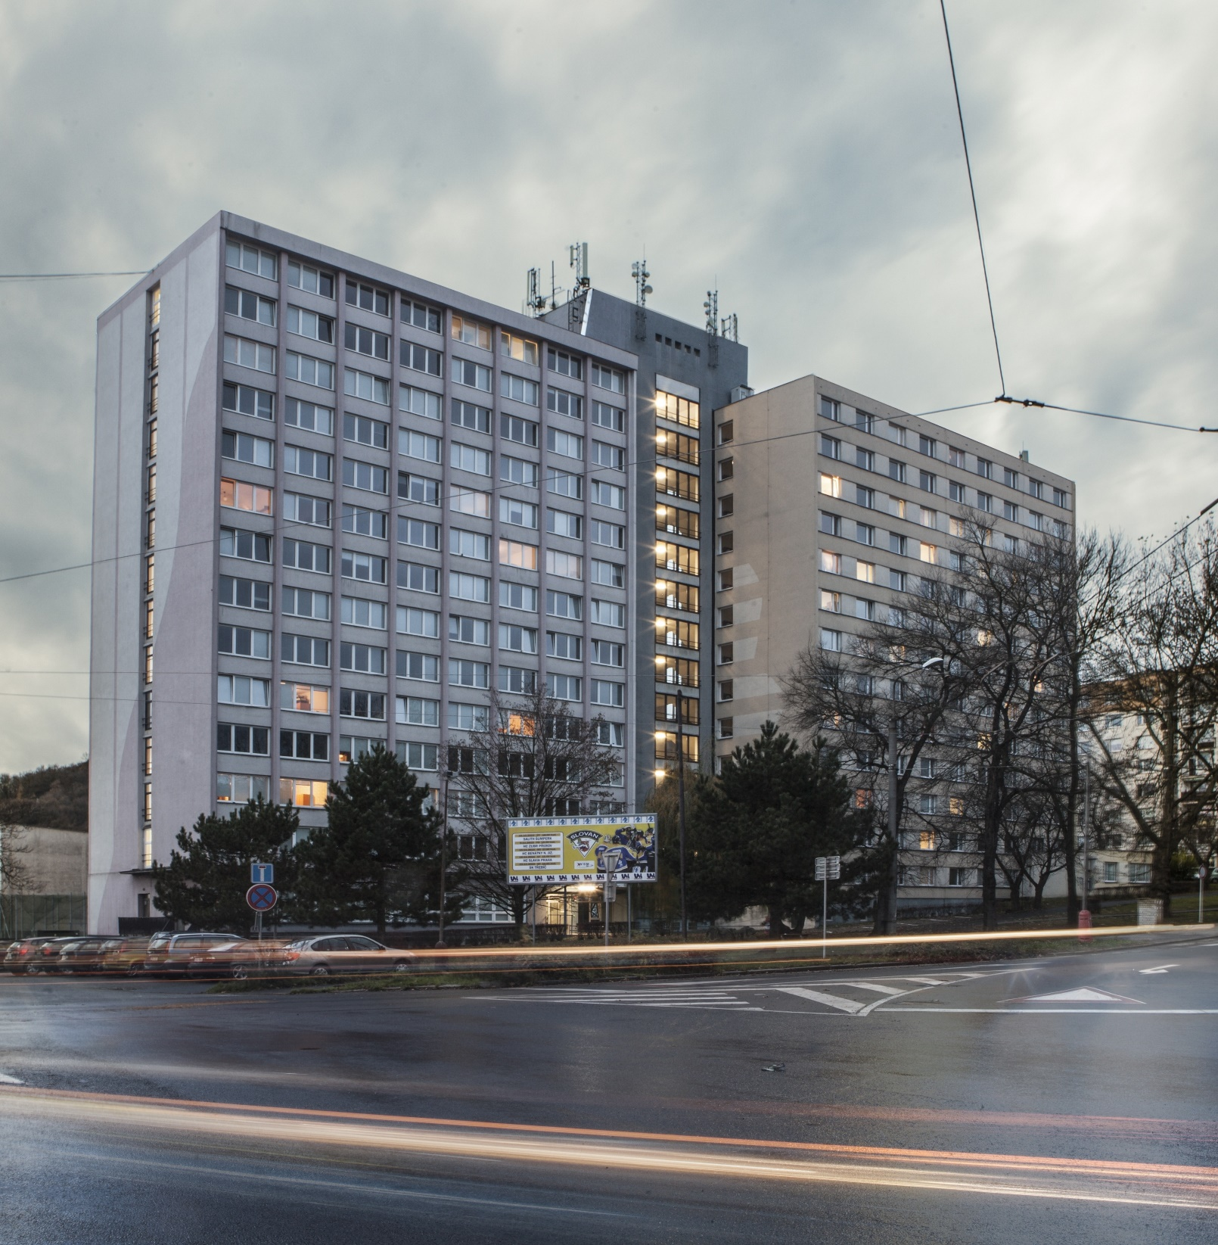
Dormitories
UJEP‘s dormitories
Our university has a large enough capacity to house its students thanks to three buildings located in close proximity to the main campus
(10 minutes by foot).
Included in our dormitories, besides the individual flats, are loundry room, music room, and IT and social room.

Slide 32
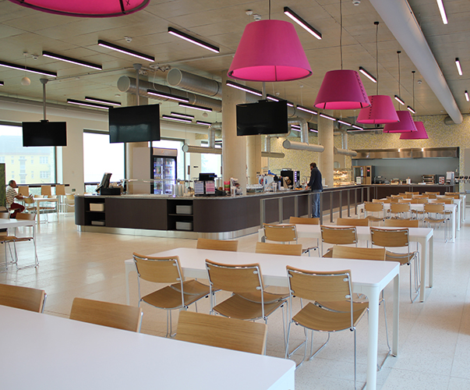
Catering facility
Catering facility
UJEP has its own on-campus catering facility in our new Center for Natural Science and Technical Studies building.
You can choose from a range of main meals. Included as part of the daily offer are various desserts, drinks and other food.
Students and employees of UJEP receive discount for a main meal.

Slide 33

Library
Scientific Library and bookshop
The Science Library provides 212 study places and a collection of 315 thousands items. It hosts a large number of cultural and educational events.
There is also a collection of books from the Austrian National Library on our library premises.
The university also owns and operates its own book shop.

Slide 34
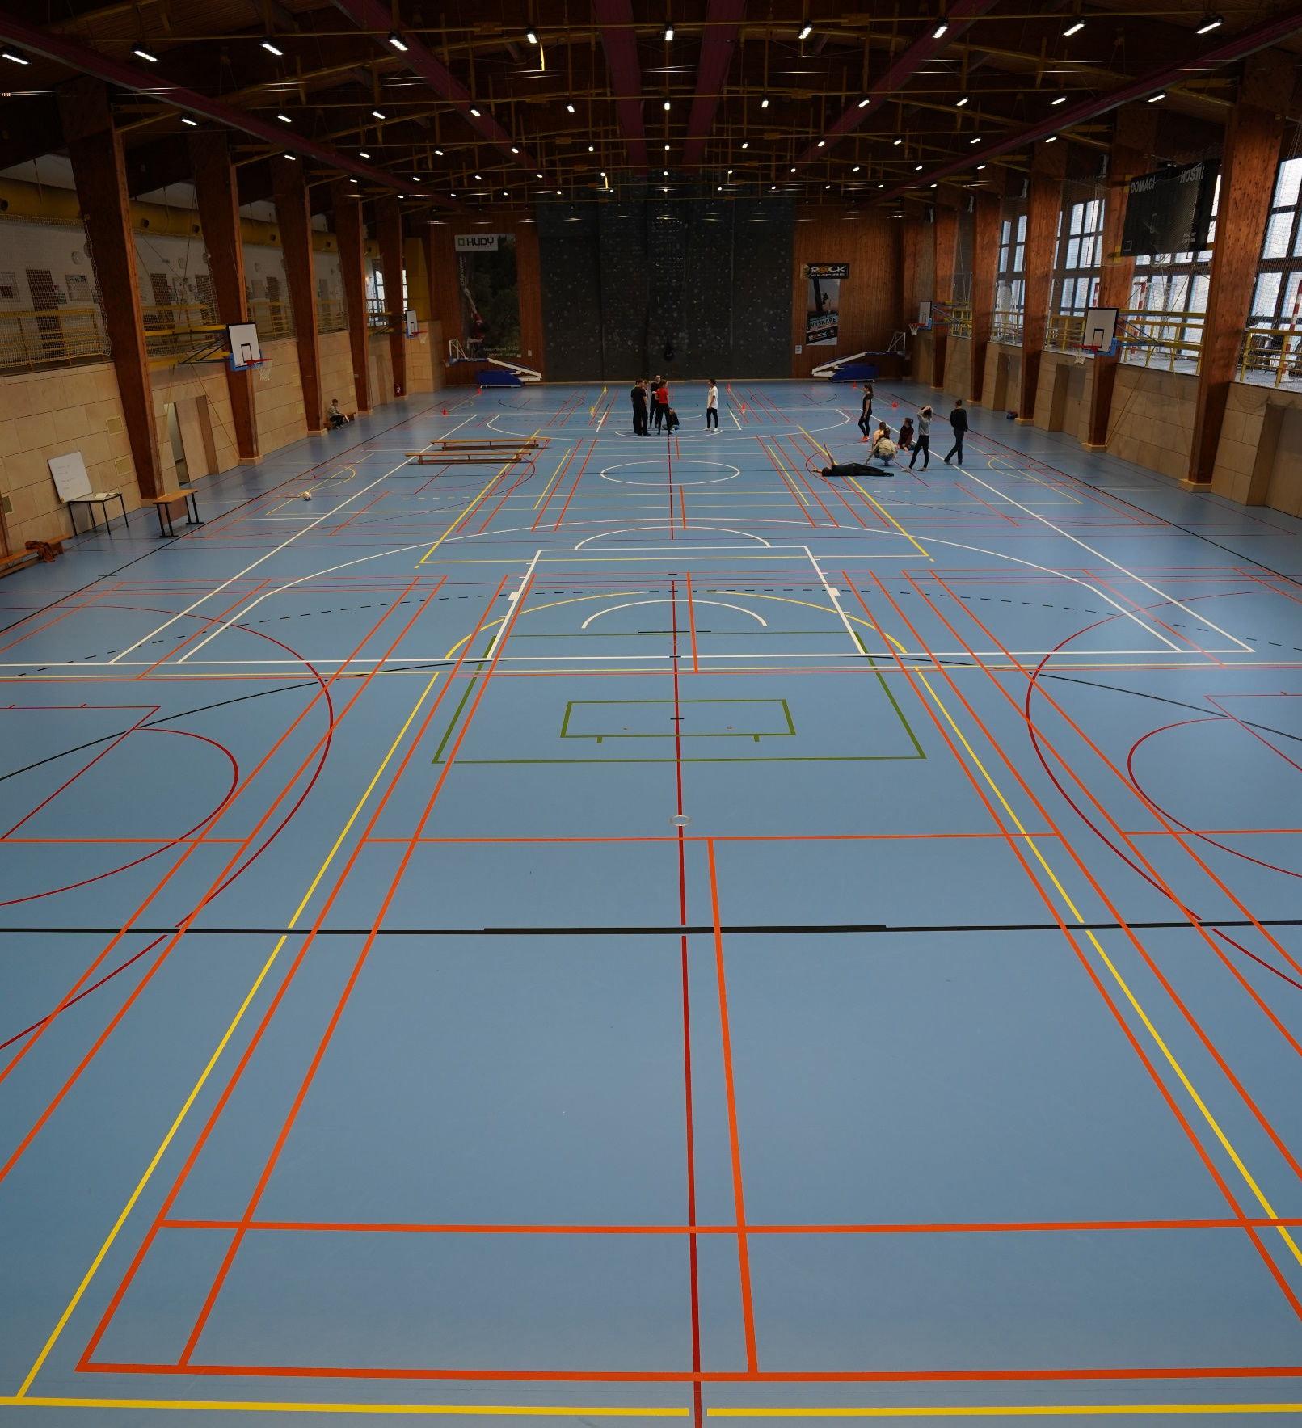
UJEP Sport
UJEP Sport
UJEP develops sport skills and knowledge, offers a wide range of sports activities.
Our modern sports hall is used mainly by students from the Department of Physical Education. It is also used by the general public.
Our university also hosts the University Sport Centre, which offers the possibility to connect
a top-level sports career with studying.
Right under the sports hall, our students and employees can work out in the new,
well-equipped, and modern gym.

Slide 35

International cooperation
Partner institutions in the ERASMUS+ programme (300+)
Austria
Belgium
Bulgaria
Croatia
Denmark
Estonia
Finland
France
Germany
Greece
Hungary
Island
Italy
Latvia
Lithuania
North Macedonia
Norway
Poland
Portugal
Romania
Serbia
Slovakia
Slovenia
Spain
Sweden
Turkey

Slide 36
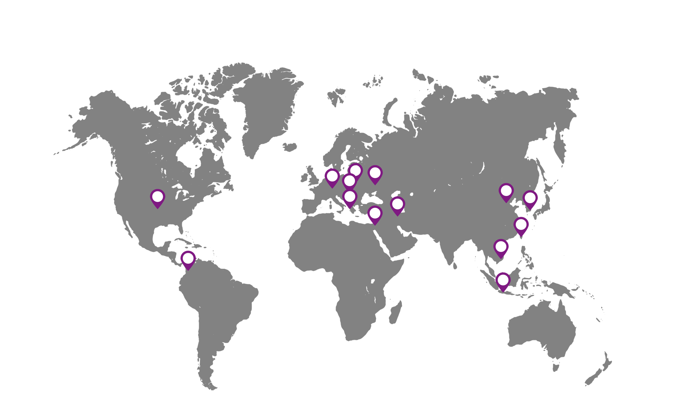
International cooperation
Partner institutions of higher education worldwide
Albania
Columbia
Germany
China
Indonesia
Iran
Israel
Kosovo
Poland
Slovakia
South Korea
Tchaj-wan
Ukraine
USA
Vietnam

Slide 37


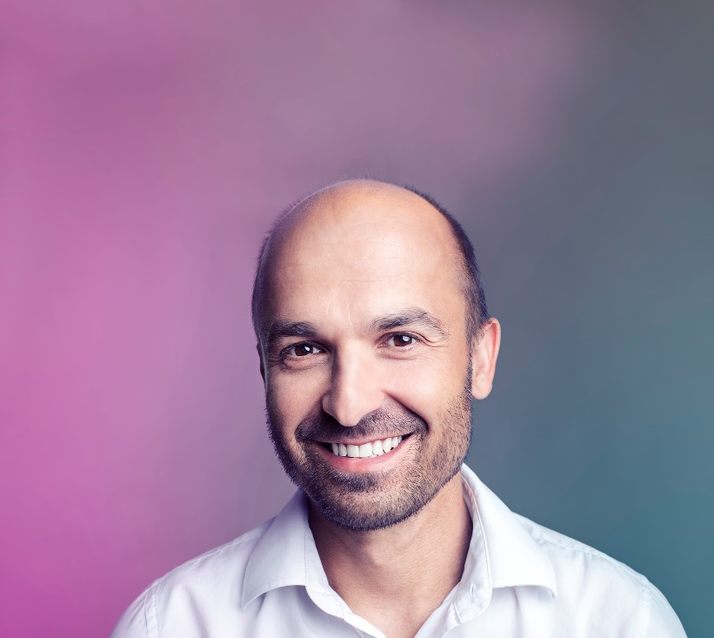

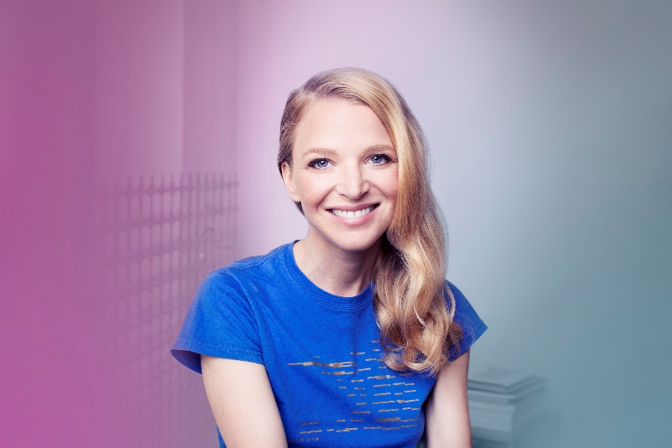
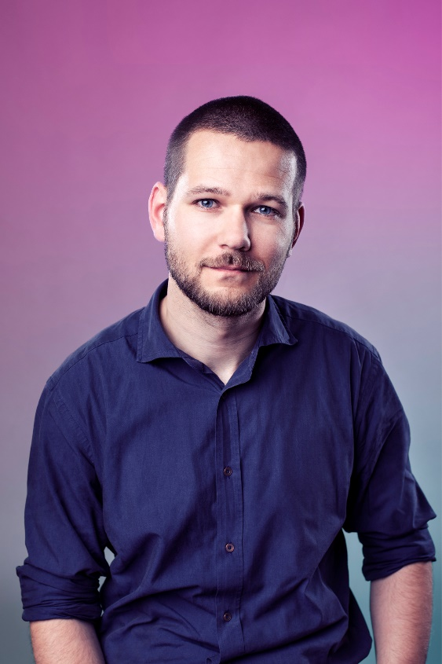

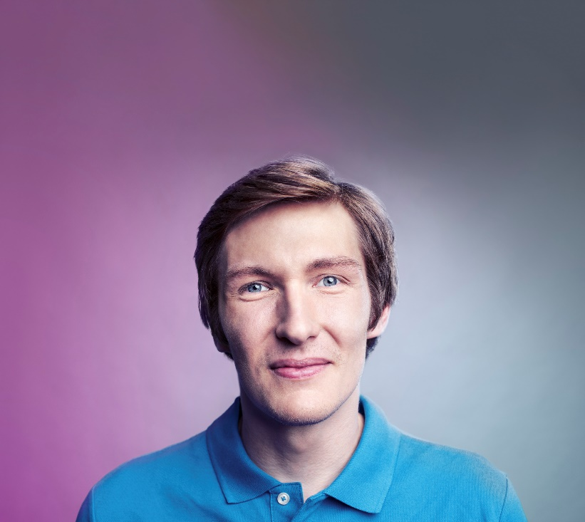

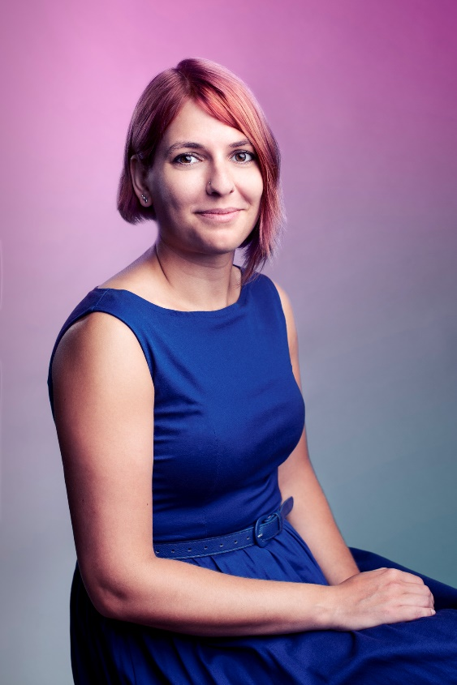



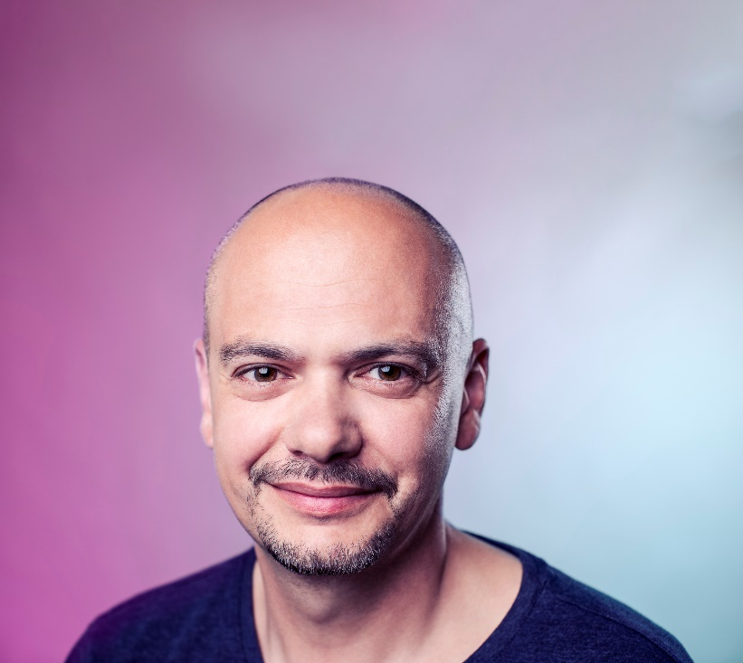
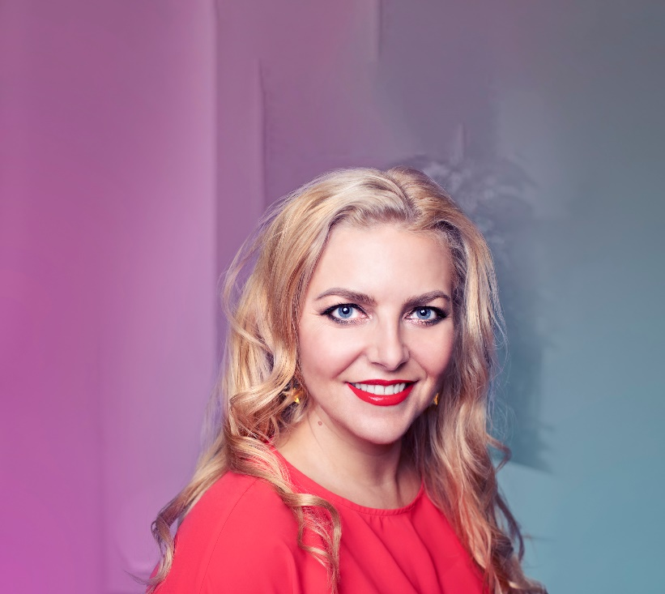
37
We are happy to establish cooperation with other partners, and to improve the mutual possibilities for students in their search for
a perfect study destination.

Slide 38
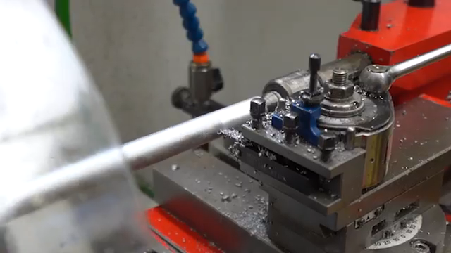

We are always looking for new partners to cooperate with in science, research and mutual study programmes.
I AM INTERESTED IN COOPERATION

